Slide 1
An AzHeC Update AHCCCS Contractors Meeting
Melissa Kotrys, MPH Chief Executive Officer
Arizona Health-e Connection (AzHeC)
November 16, 2016

Slide 2
Agenda
EHR Incentive Program
E-Prescribing
Health information exchange
Practice Innovation Institute
Strategic business plan

Slide 3
EHR Incentive Program
AzHeC supporting AHCCCS in education and outreach to increase participation in Medicaid EHR Incentive Program
Current status
Contacting all high volume providers to make sure they register by end of year if they want to participate
Will continue supporting providers in moving through the program – AIU, MU1, MU2, etc.
How you can help
Assist in outreach to providers about the program
Encourage your networks to continue proceeding through Meaningful Use

Slide 4
E-Prescribing
AzHeC supporting AHCCCS and health plans to meet increased e-prescribing goals
Current status
Finalizing strategy
Hiring clinical informatics pharmacist
Collaborating with health plan association eRx workgroup

Slide 5
The Network – Statewide HIE
Increased participation – 224 participants!
Statewide HIE Integration Plan
HIE Subsidy Program
Practice Innovation Institute (Pi Institute)
Future value-added services

Slide 6
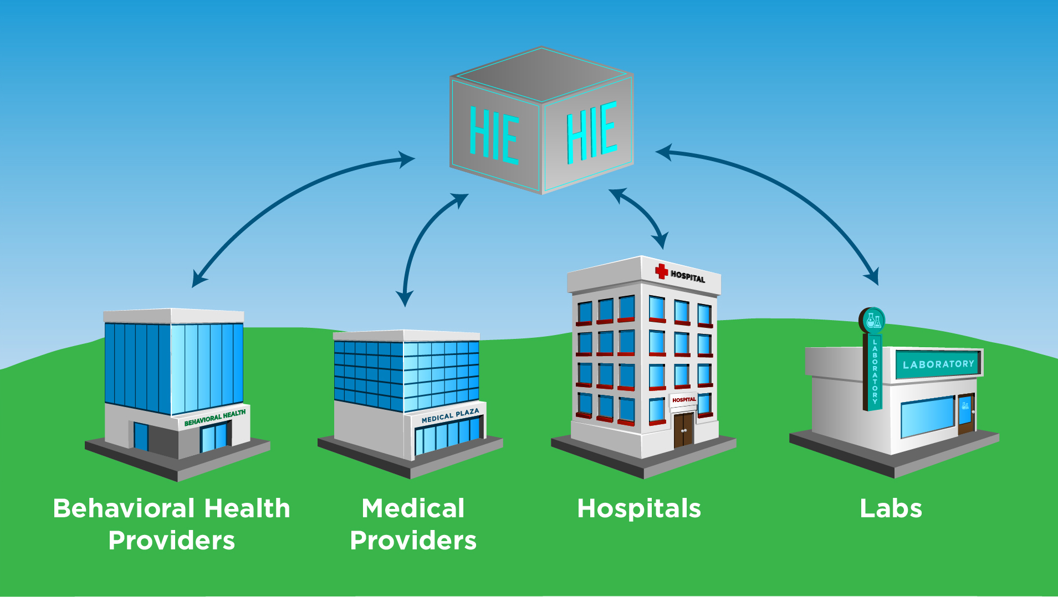
Health Information Exchange

Slide 7
The Network – Growth Participant Inpatient Discharges & ED Visits

Slide 8
Statewide HIE Integration Plan (SHIP) – The Implementation
Statewide crisis portal
Anticipate initial go-live in December
All regions live beginning Q1 2017
Bidirectional connectivity of top BH providers supported by all 3 RBHAs
Two year plan to connect top 100 high priority behavioral health providers
Connecting top 90-100 BH providers statewide via bidirectional connections (see handout)
Behavioral health providers
Behavioral health hospitals
Includes financial support for EHR interface costs – $11,000 once bidirectional exchange achieved

Slide 9
HIE Subsidy Program (Medicaid 90/10 Funding)
AHCCCS contracts with AzHeC to connect hospitals, FQHCs, FQHC-LAs, RHCs and provider practices
Eligibility Updates
The following entities are now eligible:
Hospitals
FQHCs & FQHC Look-Alikes
Rural health clinics
Any AHCCCS provider participating in EHR Incentive Program
Subsidy – Set subsidy, based upon type of entity
Hospitals - $20,000
FQHCs, FQHC-LA, RHCs - $10,000
Practices (25+ providers) - $10,000
Practices (1-25 providers) - $5,000

Slide 10
HIE Subsidy Program (Medicaid 90/10 Funding)
We need your help to spread the word about this program & enroll priority providers
Action items
Tell us who your high priority providers are that you want connected to the HIE
Help us get information about The Network out via your communication channels
Discuss additional collaborative opportunities with us to meet your strategic business objectives

Slide 11
Practice Innovation Institute (Pi Institute) Key Facts
$3.6 million from CMS with a potential up to $14.6 million over four years
Engagement and practice transformation for 2,500 Arizona Clinicians
Collaboration of AzHeC, Mercy Care Plan & Mercy Maricopa Integrated Care
Connection to the statewide HIE, including pop health & data analytics to enhance communications and care coordination
One-on-one consulting valued at $50K+ per practice
Collaboration with QIN-QIO and professional medical associations to advance practice transformation
Assistance in integrating physical & behavioral health care

Slide 12
Pi Institute: Advancing Care in the Value-Based Marketplace
Other Managed Care Organizations (MCOs)
Mercy Care
Plan / Mercy Maricopa Integrated
Care
HSAG (Arizona’s QIN-QIO)
Practice Innovation
Institute
Practice transformation
Education/training – Pii Academy
HIE connectivity
Pop health & data analytics
Patient & family engagement
Arizona Health-e
Connection
Clinically integrated networks
CMS (MACRA/MIPS)
AHCCCS
Source: CMS, MCP / AzHeC management interviews, L.E.K. research and analysis

Slide 13
Value-Added Services
Electronic Image Sharing
Population Health
Core HIE Services
Medication History/ Reconciliation
Data Analytics
Community Care Plans
Future Infrastructure & Value –Added
Services
Current Infrastructure & Services

Slide 14
Value-Added Services: Options for Consideration
Population Health Management*
Health Care Analytics*
Community Care Plans
Medication Fill History
Electronic Image Sharing
Community Referral Management
Community Scheduling
Advanced Directives, Power of Attorney & POLST
Consent Management & Identity Proofing
Personal Health Record
Advanced Reporting
Bundled Payment Support
Secure Text Messaging+
*Note: these services have been acquired for TCPI, but are being evaluated for non-TCPI uses.
Notes:
*Note: these services have been acquired for TCPI, but need to be evaluated for non-TCPI uses.

Slide 15
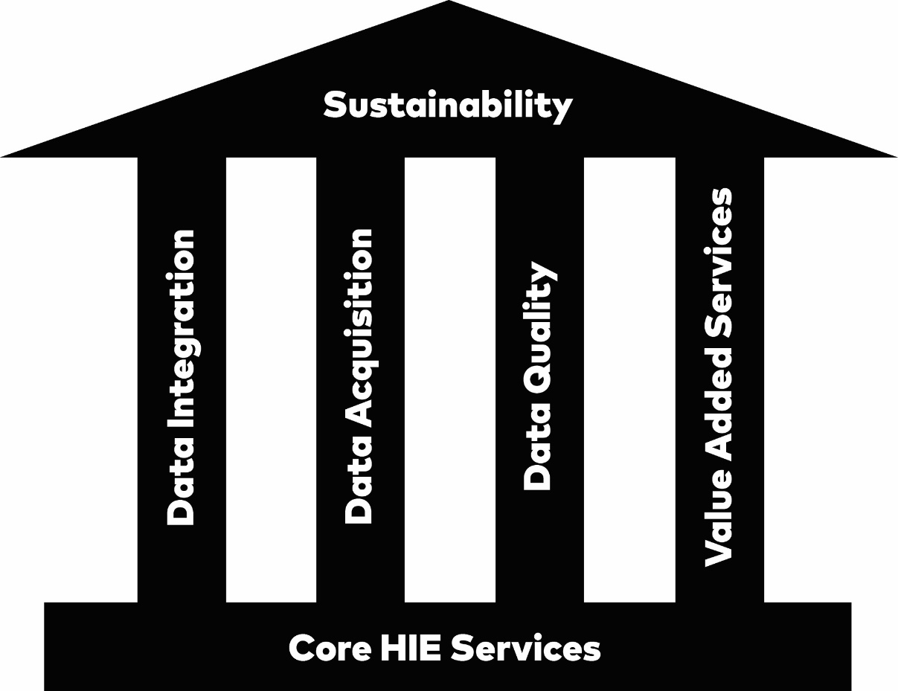
AzHeC Strategic Plan – Four Pillars of Success
Notes:
So how do we make this happen?
From a product and service standpoint, we’ve identified four directional pillars we need to pursue
These pillars collectively recognize our need to shift from building a constituency to providing value to that constituency
It involves four parallel efforts sitting above our current Core HIE Services
Data Integration and Strategic Partnerships—If it is not being used in your workflows, it isn’t of value
Data Acquisition—Filling in the holes in our longitudinal record
Data Quality—Optimizing the usability of the data
Value Added Services—Offer a broader set of customer needed services to leverage the rich underlying dataset
As we build these pillars, we move towards sustainability

Slide 16
Questions?
602-688-7200
melissa.kotrys@azhec.org
www.azhec.org

