Slide 1
AHCCCS Pharmacy and Therapeutics Committee
October 19, 2022

Slide 2
Welcome and Introductions
Suzi Berman, RPh, AHCCCS Pharmacy Director
May 24, 2022 - P&T Minutes Review and Vote
All submitted written testimony will be posted on the AHCCCS website under Pharmacy/Pharmacy & Therapeutics Committee

Slide 3
Magellan Class Reviews
Classes for Review: Non-Supplemental Rebate Class Review
Antimigraine Agents, Triptans
Leukotriene Modifiers
Sedative Hypnotics
Topical Steroids – Low, Medium, High & Very High Potency
Antifungals, Oral
Antifungals, Topical

Slide 4
Magellan Class Reviews
Classes for Review: Non-Supplemental Rebate Class Review
Beta Blockers
BPH Treatments
Calcium Channel Blockers
HIV/AIDS
Movement Disorders
Phosphate Binders

Slide 5
Magellan Class Reviews
Classes for Review: Supplemental Rebate Class Review
Hereditary Angioedema Agents
Immunomodulators, Atopic Dermatitis

Slide 6
Magellan Drug Class Reviews
Hind Douiki, Pharm.D.

Slide 7
Antimigraine Agents, Triptans

Slide 8
Antimigraine Agents, Triptans
Class Overview:
almotriptan malate - (almotriptan)
eletriptan - (eletriptan; Relpax)
frovatriptan - (frovatriptan; Frova)
naratriptan - (Amerge; naratriptan)
rizatriptan - (Maxalt, Maxalt MLT; rizatriptan ODT & tablet)
sumatriptan - (Imitrex Kit, Tablet & Vial; Imitrex Nasal; sumatriptan kit, nasal, tablet & vial; Onzetra Xsail; Sumavel DosePro; Zembrace SymTouch)

Slide 9
Antimigraine Agents, Triptans
Class Overview:
sumatriptan/naproxen - (sumatriptan/naproxen; Treximet)
sumatriptan camphor/menthol - (Migranow)
zolmitriptan - (zolmitriptan ODT, ODT (AG), tablets, tablets (AG), nasal spray; Zomig)

Slide 10
Antimigraine Agents, Triptans
Migraines account for 10% to 20% of all headaches in adults and affect over 39 million men, women, and children in the United States
Migraine headaches must be differentiated from regular tension-type headaches.
Key criteria for migraine diagnosis include an episodic headache lasting from 4 to 72 hours with at least two of the following: unilateral pain, throbbing, aggravation of pain upon moving, pain of moderate to severe intensity accompanied by nausea, vomiting, photophobia, or phonophobia
Non-opioid analgesia with acetaminophen, nonsteroidal anti-inflammatory drugs (NSAIDs), or caffeinated combinations are considered first-line therapy for mild to moderate migraine pain

Slide 11
Antimigraine Agents, Triptans
Migraine-specific agents (triptans, dihydroergotamine [DHE]) should be used in patients who experience moderate to severe migraine attacks
Due to well-established efficacy, triptans have become the drugs of choice for treating acute migraine attacks
The US Headache Consortium, a multidisciplinary panel of several professional organizations, recognized that all of the triptans are effective agents for the acute treatment of migraine
Data reviewed did not demonstrate that any specific triptan was superior to others and triptans appear to be equally safe

Slide 12
Antimigraine Agents, Triptans
Per the American Academy of Neurology (AAN) and the American Headache Society (AHS), for pharmacologic treatment for episodic migraine prevention in adults:
Antiepileptic drugs (divalproex sodium, sodium valproate, topiramate) and beta-blockers (metoprolol, propranolol, timolol) are considered effective in migraine prevention
Naratriptan, zolmitriptan, antidepressants (amitriptyline, venlafaxine), and beta-blockers (atenolol, nadolol) are considered probably effective in migraine prevention
Frovatriptan is established for short-term menstrually-associated migraine (MAM) prevention

Slide 13
Antimigraine Agents, Triptans
In addition to approval in adults, almotriptan, sumatriptan/naproxen, and zolmitriptan nasal spray are FDA-approved for use in patients 12 to 17 years old while rizatriptan is approved in patients 6 to 17 years old
Non-oral routes of administration are available when nausea or vomiting present as significant components of migraine attacks

Slide 14
Leukotriene Modifiers

Slide 15
Leukotriene Modifiers
Class Overview:
montelukast - (montelukast chewable tablet, granules & tablet; Singulair Chewable Tablet, Granules & Tablet)
zafirlukast - (Accolate; zafirlukast)
zileuton- (zileuton ER; Zyflo; Zyflo CR)

Slide 16
Leukotriene Modifiers
Zafirlukast, zileuton, and zileuton ER are only approved for prophylaxis and chronic treatment of asthma
Montelukast is the only leukotriene modifier that is approved for asthma and allergic rhinitis and can be considered for patients with these two co-morbidities
National Asthma Education and Prevention Program (NAEPP) and Global Initiative for Asthma (GINA) guidelines recommend inhaled corticosteroids (ICS) as the cornerstone for the treatment of asthma
Leukotriene modifiers are included as potential alternatives or add-on therapy in some patients
GINA states that leukotriene modifiers are less effective than ICS, but may be appropriate for initial controller treatment for patients unable or unwilling to use ICS, intolerant to ICS, or who also have allergic rhinitis

Slide 17
Leukotriene Modifiers
Leukotriene modifiers are also used as add-on therapy to reduce the dose of the ICS in patients with moderate to severe asthma, and to potentially improve asthma control in patients whose asthma is not controlled with low or high doses of ICS
Limited data exist to support the use of leukotriene modifiers in acute asthma
The American Academy of Allergy, Asthma and Immunology (AAAAI), the American College of Allergy, Asthma, and Immunology (ACAAI), and the American Academy of Otolaryngology, Head and Neck Surgery recommend intranasal corticosteroids (INCS) as first line treatment for patients with seasonal allergic rhinitis (SAR)
Montelukast is considered an alternative to first-line therapy with INCS in patients who suffer from both asthma and SAR

Slide 18
Leukotriene Modifiers
The International Consensus Statement on Allergy and Rhinology Allergic Rhinitis guidelines state that leukotriene receptor antagonist monotherapy can be a useful alternative in patients with contraindications for INCSs and oral antihistamines
Currently, high-quality comparative trials of the leukotriene modifiers are limited
Montelukast is the most widely used leukotriene modifier because of its multiple indications, once daily dosing, and ease of administration due to several different dosage forms

Slide 19
Sedative Hypnotics

Slide 20
Sedative Hypnotics
Class Overview: Benzodiazepine Agents
estazolam - (estazolam)
flurazepam - (flurazepam)
quazepam – (Doral; quazepam)
temazepam - (Restoril; temazepam)
triazolam - (Halcion; triazolam)

Slide 21
Sedative Hypnotics
Class Overview: Non-Benzodiazepine Agents
daridorexant (Quviviq)
doxepin - (doxepin; Silenor)
eszopiclone - (eszopiclone; Lunesta)
lemborexant - (Dayvigo)
ramelteon - (ramelteon; Rozerem)
suvorexant - (Belsomra)
tasimelteon - (Hetlioz capsule; Hetlioz LQ)
zaleplon - (Sonata; zaleplon)
zolpidem - (Ambien; Ambien CR; Edluar; Intermezzo; zolpidem; zolpidem SL; zolpidem ER; Zolpimist)

Slide 22
Sedative Hypnotics
Insomnia is a symptom complex that comprises difficulties falling asleep, staying asleep, or non-refreshing sleep, in combination with daytime dysfunction or distress
Non-pharmacological measures should be used first to treat insomnia
The 2017 American Academy of Sleep Medicine (AASM) guidelines recommend psychological and behavioral strategies, as well as pharmacological interventions
The guidelines recommend that initial behavioral interventions should include stimulus control or relaxation therapy, or a combination of therapies referred to as cognitive behavioral therapy (CBT) for insomnia

Slide 23
Sedative Hypnotics
AASM guidelines recommend that pharmacotherapy should be used to treat patients who failed to respond to CBT
AASM recommends:
Zaleplon, triazolam, and ramelteon versus no treatment for sleep onset insomnia
Suvorexant and doxepin over no treatment for sleep maintenance insomnia
Eszopiclone, zolpidem, and temazepam for both sleep onset and sleep maintenance insomnia
Against the use of trazodone or tiagabine for sleep onset or for sleep maintenance insomnia in adults
Against the use of OTC medications, supplements, or herbal products as a treatment for sleep onset or sleep maintenance for chronic insomnia

Slide 24
Sedative Hypnotics
Current treatment guidelines for insomnia do not recommend one agent within this class over another, suggesting treatment be individualized
Choice of agent should be based on:
Symptom pattern
Treatment goals
Past treatment response
Patient preference
Cost
Availability of other treatments options
Comorbid conditions
Contraindications
Potential interactions with concurrent medications
Adverse effects

Slide 25
Sedative Hypnotics
Non-24-hour sleep-wake disorder (N24SWD or non-24) is a chronic circadian rhythm disorder that causes problems with the timing of sleep and sleep patterns
Tasimelteon capsule (Hetlioz) is approved for non-24 in totally blind adults and for nighttime sleep disturbances in Smith-Magenis Syndrome (SMS) in patients ≥ 16 years of age
Newly approved tasimelteon oral suspension (Hetlioz LQ) is indicated for nighttime sleep disturbances in SMS in pediatric patients 3 years to 15 years of age only
Tasimelteon capsules (Hetlioz) and oral suspension (Hetlioz LQ) are not interchangeable

Slide 26
Sedative Hypnotics
With the exception of zolpidem SL, all agents should be administered immediately before going to bed or after the patient has gone to bed and experienced difficulty falling asleep
Zolpidem SL should be utilized for middle of the night awakenings when the patient still has more than 4 hours before planned waking time
Due to gender differences in zolpidem clearance, women generally require lower doses of zolpidem
Doxepin, ramelteon, and tasimelteon are the only agents in this class that are not controlled substances
All drugs in this class should be used at the lowest effective dose
All sedative/hypnotics should be administered with caution in patients exhibiting signs and symptoms of depression

Slide 27
Sedative Hypnotics
Patients whose insomnia fails to remit after 7 to 10 days of treatment may need to be evaluated for other medical or psychological issues
Continuous use should be avoided; patients should be encouraged to use these medications only when necessary
Concurrent use of opioids and benzodiazepines or other CNS depressants may result in serious adverse reactions such as profound sedation, respiratory depression, coma, and death
Providers should limit prescribing opioids with benzodiazepines to only patients without alternative treatment options
The benzodiazepines carry boxed warnings for the risk of abuse, misuse, addiction, dependence, and withdrawal
A gradual taper to discontinue or reduce the dose is required to prevent acute withdrawal symptoms which could be fatal

Slide 28
Steroids, Topical

Slide 29
Steroids, Topical
Class Overview: Low Potency Topical Steroid Products
alclometasone dipropionate – (alclometasone dipropionate cream & ointment)
desonide – (Desonate Gel; Desowen Cream; desonide cream, lotion & ointment; Tridesilon; Verdeso)
fluocinolone acetonide – (Capex Shampoo; Dema-Smoothe-FS; fluocinolone 0.01% oil)
fluocinolone acetonide/Cetaphil cleanser lotion (Xilapak Kit)
fluocinolone acetonide/ urea* (NoxiPak Kit)

Slide 30
Steroids, Topical
Class Overview: Low Potency Topical Steroid Products
hydrocortisone (Advanced Allergy Collection Kit, Ala-Cort, Ala-Scalp, Aquanil, Anti-Itch, Aqua Glycolic HC Kit, Beta HC, Cortaid, Cortisone, Cortizone, Dermarest Eczema, Dermasorb HC Complete Kit, GS Anti-Itch, MiCort HC, Noble Formula HC, QC Anti-Itch, Scalacort, Scalacort-DK Kit, Scalp Relief, Scalpicin, Soothing Care, Texacort, Vanicream; hydrocortisone)
hydrocortisone/aloe vera (Cortisone-10, Cortisone Plus Aloe, Nucort, QC Anti-Itch with Aloe, SM Hydrocortisone-Aloe, SM Hydrocortisone Plus; hydrocortisone/aloe vera)

Slide 31
Steroids, Topical
Class Overview: Medium Potency Topical Steroid Products
betamethasone valerate - (betamethasone valerate foam; Luxiq)
clocortolone pivalate - (clocortolone cream (AG); Cloderm)
fluocinolone acetonide - (fluocinolone acetonide cream, ointment & solution; Synalar Ointment & Solution)
flurandrenolide - (Cordran Tape; flurandrenolide cream, lotion, (AG) & ointment; Nolix)
fluticasone propionate - (Cutivate Cream & Lotion; fluticasone cream, lotion & ointment)

Slide 32
Steroids, Topical
Class Overview: Medium Potency Topical Steroid Products
hydrocortisone butyrate - (hydrocortisone butyrate cream, cream (AG), lotion, ointment, ointment (AG), solution & solution (AG); Locoid / Lipocream)
hydrocortisone probutate - (Pandel)
hydrocortisone valerate - (hydrocortisone valerate cream & ointment)
mometasone furoate - (Elocon Cream & Ointment; mometasone furoate cream, ointment & solution )
prednicarbate - (Dermatop; prednicarbate cream & ointment)

Slide 33
Steroids, Topical
Class Overview: High Potency Topical Steroid Products
amcinonide - (amcinonide cream & lotion)
betamethasone dipropionate - (betamethasone dipropionate cream, gel, lotion & ointment; Sernivo Spray)
betamethasone valerate - (betamethasone valerate cream & ointment)
betamethasone dipropionate augmented cream (Diprolene AF)
desoximetasone - (desoximetasone cream, gel & ointment; Topicort Ointment & Spray)
diflorasone diacetate - (diflorasone diacetate cream & ointment)
fluocinonide - (fluocinonide cream, gel, ointment & solution; Vanos)

Slide 34
Steroids, Topical
Class Overview: High Potency Topical Steroid Products
fluocinonide/emollient - (fluocinonide emollient)
halcinonide - (Halog Cream & Ointment)
triamcinolone acetonide/dimethicone - (Ellzia Pak)
triamcinolone acetonide/silicones - (DermacinRx Silazone; Silazone-II)
triamcinolone acetonide - (Kenalog Aerosol; triamcinolone acetonide aerosol, cream, lotion & ointment; Trianex Ointment)
triamcinolone acetonide/dimethicone/silicones - (DermacinRx Silapak; triamcinolone acetonide/dimethicone)
triamcinolone/emollient - (Dermasorb TA)

Slide 35
Steroids, Topical
Class Overview: Very High Potency Topical Steroid Products
clobetasol propionate - (Impeklo)
clobetasol propionate - (clobetasol lotion; clobetasol propionate cream, gel, ointment, solution, spray & spray (AG); clobetasol shampoo; Clobex Lotion, Shampoo & Spray; Olux; Temovate Cream)
clobetasol propionate/clobetasol propionate/emollient - (clobetasol propionate foam)
clobetasol propionate/emollient - (clobetasol propionate/emollient )
clobetasol propionate/skin cleanser - (Clodan Kit)
diflorasone diacetate/emollient - (Apexicon E)

Slide 36
Steroids, Topical
Class Overview: Very High Potency Topical Steroid Products
halobetasol propionate - (halobetasol propionate cream & ointment; Ultravate Lotion)
halobetasol/lactic acid - (Ultravate X Pac Cream & Ointment)
Halobetasol propionate foam - (Lexette)
halobetasol propionate lotion - (Bryhali)

Slide 37
Steroids, Topical
Topical corticosteroids are used in a variety of inflammatory skin conditions
Atopic dermatitis (AD) is a chronic, inflammatory dermatologic condition and is often referred to as “eczema”
AD commonly occurs in patients affected by asthma and/or allergic rhinitis and is associated with elevated serum IgE levels
AD can present at any age, but prevails most frequently in children
Psoriasis is another inflammatory skin condition, with plaque psoriasis being the most common type frequently forming on the elbows, knees, lower back, and scalp
Alternating the use of topical corticosteroids with non-corticosteroids or steroid-sparing agents (e.g., vitamin D analogs, tazarotene, calcineurin inhibitors) is also recommended as a means of mitigating the potential side effects of topical corticosteroids

Slide 38
Steroids, Topical
Seborrheic dermatitis is an inflammatory disorder affecting areas of the head and trunk, where sebaceous glands are most prominent
Pharmacotherapy choices for these conditions include emollients and topical corticosteroids
Emollients remain the cornerstone of any AD treatment regimen
Topical corticosteroids are the standard of care to which other treatments are compared
The selection of medication and potency should depend on:
Medication efficacy
Severity of disease
Location and surface area of affected skin
Intended duration of treatment

Slide 39
Steroids, Topical
Medication vehicle
Patient preference
Patient age
In short-term durations of treatment, high potency medications have greater efficacy when compared to less potent medications, but with an increased risk in side effects
Increased incidences of adverse dermatologic reactions are positively correlated with the medication’s frequency and duration of use
True efficacy and risk of long-term topical corticosteroid use is unknown because most clinical trials only involved short-term studies

Slide 40
Steroids, Topical
Treatment guidelines from the American Academy of Dermatology recommend that continued therapy be supervised and a gradual reduction in utilization is appropriate once a clinical response is demonstrated
There are differing compendia listings for corticosteroid potencies
Efficacy of topical corticosteroids is relative to their potency, but individual agents within a potency category are not distinguishable from each other

Slide 41
Antifungals, Oral

Slide 42
Antifungals, Oral
Class Overview - Product indications include*:
Candidiasis (esophageal, oropharyngeal, and vaginal)
Cryptococcal infections
Tinea topical infections
Onychomycosis
Invasive aspergillosis
*Not inclusive of all product indications, all products differ in indication

Slide 43
Antifungals, Oral
Class Overview:
clotrimazole troche - (clotrimazole troche)
fluconazole - (Diflucan, fluconazole)
flucytosine - (Ancobon, flucytosine)
griseofulvin suspension - (griseofulvin suspension)
griseofulvin microsized - (griseofulvin microsized)
griseofulvin ultramicrosized - (griseofulvin ultramicrosized)
ibrexafungerp - (Brexafemme)
isavuconazonium - (Cresmba)
itraconazole - (itraconazole, Onmel, Sporanox)
itraconazole – (Tolsura)

Slide 44
Antifungals, Oral
Class Overview
ketoconazole - (ketoconazole)
miconazole - (Oravig)
nystatin - (nystatin)
posaconazole - (Noxafil)
terbinafine - (terbinafine)
voriconazole - (Vfend, voriconazole)

Slide 45
Antifungals, Oral
Antifungal agents have different spectrums of activity and are FDA-approved to treat a variety of infections
Oral antifungal agents are useful in the treatment of a variety of infections in both immunocompetent and immunocompromised patients
Few trials have been performed to compare safety and efficacy profiles of the drugs
Many of the agents carry boxed warnings related to adverse events and/or drug interactions
After bacterial vaginal infections, Vulvovaginal Candidiasis (VVC) is the second most common type of vaginal infection in the US
It is estimated that treatment with azole antifungals provides relief of symptoms and negative cultures in 80% to 90% of patients with uncomplicated VVC

Slide 46
Antifungals, Oral
Due to its excellent penetration into many tissues, fluconazole is an effective Candida treatment for a variety of infections, lacking concerns about pH-dependent absorption such as that seen with ketoconazole
Effective therapy for oropharyngeal candidiasis includes fluconazole, itraconazole, ketoconazole, nystatin, and clotrimazole
Voriconazole has been shown to have similar efficacy to fluconazole in the treatment of esophageal candidiasis; however, more adverse effects are reported with voriconazole
Posaconazole oral suspension has an indication for treatment of oropharyngeal candidiasis when refractory to itraconazole and/or fluconazole

Slide 47
Antifungals, Oral
Posaconazole delayed-release oral tablets are indicated to treat invasive aspergillosis
Nystatin is also used to treat intestinal candidiasis and may be used in infants and children
Isavuconazonium, posaconazole, flucytosine, voriconazole, itraconazole, and fluconazole have indications for the treatment and/or prophylaxis of various serious fungal infections

Slide 48
Antifungals, Topical

Slide 49
Antifungals, Topical
Class Overview - Product indications include*:
Cutaneous Candidiasis
Tinea Pedis
Tinea Corporis
Tinea Cruris
Tenia Versicolor
Topical Onychomycosis
Seborrheic Dermatitis
*Not inclusive of all product indications, all products differ in indication

Slide 50
Antifungals, Topical
Class Overview
butenafine - (Mentax)
butenafine - (butenafine [OTC], Lotrimin Ultra [OTC])
ciclopirox 0.77% - (Ciclodan Cream, Kit; ciclopirox cream; Loprox Cream, Gel, Suspension)
ciclopirox 8% - (Ciclodan Solution, ciclopirox 8%, Penlac)
ciclopirox 8% / triamcinolone acetonide - (Trilociclo)
clotrimazole - (Alevazol [OTC], clotrimazole [OTC], Lotrimin AF [OTC])
clotrimazole/betamethasone - (clotrimazole/betamethasone, DermacinRx Therazole Pak, Lotrisone)
econazole cream - (econazole)

Slide 51
Antifungals, Topical
Class Overview:
econazole foam - (Ecoza)
econazole / triamcinolone acetonide - (Triamazole)
efinaconazole - (Jublia)
ketoconazole - (Extina, ketoconazole, Nizoral A-D Shampoo, Nizoral Shampoo, Xolegel)
luliconazole - (Luzu)
miconazole - (Azolen [OTC], Desenex [OTC] , Fungoid [OTC], Lotrimin AF Spray, [OTC], miconazole [OTC], Zeasorb [OTC], Mycozyl AP [OTC])
miconazole/zinc oxide/white petrolatum - (Vusion)
naftifine - (naftifine, Naftin)

Slide 52
Antifungals, Topical
Class Overview
nystatin - (nystatin)
nystatin/triamcinolone - (nystatin/triamcinolone)
oxiconazole - (oxiconazole, Oxistat)
sertaconazole - (Ertazco)
sulconazole - (Exelderm)
tavaborole - (Kerydin)
terbinafine - (Lamisil [OTC], Lamisil AT [OTC], terbinafine [OTC])
tolnaftate - (Fungoid-D [OTC], Lamisil AF Defense [OTC], Tinactin [OTC], tolnaftate [OTC])
undecylenic acid - (Hongo Cura, Sponix Anti-Fungal [OTC])
undecylenic acid/zinc undecylenic - (Fungi-Nail [OTC], Hongo Cura [OTC])

Slide 53
Antifungals, Topical
Topical antifungal agents have different spectrums of activity and are FDA-approved to treat a variety of infections
Topical agents may be formulated as creams, foams, gels, lacquers, lotions, ointments, powders, solutions and sprays
Many topical antifungal preparations are available as prescription medications and over-the-counter (OTC) products
Limited data are available regarding comparative efficacy in the treatment of the various fungal infections — tinea cruris, tinea corporis, tinea pedis, and tinea versicolor
Combination therapy (antifungal plus corticosteroid) can be considered when inflammation is present

Slide 54
Antifungals, Topical
Data are also lacking in comparative efficacy for the treatment of seborrheic dermatitis
Based on limited efficacy data, choice of therapy is mainly based on clinical judgment with regard to prior treatments and complicating conditions, such as bacterial growth or intense inflammation

Slide 55
Beta Blockers

Slide 56
Beta Blockers
Class Overview - Product indications include*:
Hypertension
Heart Failure
Angina pectoris
Myocardial Infarction
Cardiac Arrhythmias
Migraine Prophylaxis
Tremor
Hypertrophic subaortic stenosis
*Not inclusive of all product indications, all products differ in indication

Slide 57
Beta Blockers
Class Overview: Single Agents
acebutolol - (acebutolol, Sectral)
atenolol - (atenolol, Tenormin)
betaxolol - (betaxolol)
bisoprolol - (bisoprolol)
carvedilol - (carvedilol, Coreg)
carvedilol extended-release - (carvedilol ER, Coreg CR)
labetalol - (labetalol)
metoprolol succinate ER - (metoprolol succinate ER, Toprol XL, Kapspargo Sprinkle)
metoprolol tartrate - (Lopressor, metoprolol tartrate)

Slide 58
Beta Blockers
Class Overview: Single Agents
nadolol - (Corgard, nadolol)
nebivolol - Abbvie has made a business decision to discontinue brand Bystolic
pindolol - (pindolol)
propranolol - (propranolol)
propranolol - (Hemangeol)
propranolol ER - (Inderal XL, Innopran XL)
propranolol LA - (Inderal LA, propranolol LA)
sotalol - (Betapace, sotalol)
sotalol - (Betapace AF, sotalol AF)
sotalol - (Sotylize)
timolol - (timolol)

Slide 59
Beta Blockers
Class Overview: Beta-Blocker/Diuretic Combinations
atenolol/chlorthalidone - (atenolol/chlorthalidone, Tenoretic)
bisoprolol/HCTZ - (bisoprolol/HCTZ , Ziac)
metoprolol succinate/HCTZ - (Dutoprol, metoprolol succinate/HCTZ)
metoprolol tartrate/HCTZ - (metoprolol tartrate/HCTZ)
nadolol/bendroflumethiazide - (Corzide, nadolol/bendroflumethiazide)
propranolol/HCTZ - (propranolol/HCTZ)

Slide 60
Beta Blockers
Approximately 116 million (47%) of adults in the United States have hypertension
Highest prevalence is among African American adults and men at 56% and 50%, respectively
It is estimated that hypertension is controlled in only 24% of patients with the condition
Hypertension is an independent risk factor for the development of cardiovascular disease (CVD)
Beta-blockers are one of the classes suggested as first-line therapy in patients with coronary artery disease (CAD), post-MI, and HF

Slide 61
Beta Blockers
Beta-blockers have similar efficacy for the treatment of hypertension (HTN)
The Eighth Report of the Joint National Committee on Prevention, Detection, Evaluation, and Treatment of High Blood Pressure (JNC-8) does not recommend beta-blockers as initial treatment for hypertension
This is due to a demonstrated higher rate of the primary composite outcome of CV death, MI, or stroke compared to use of an ARB with beta blocker use, a finding that was driven largely by an increase in stroke
Beta-blockers prevent recurrent ischemia, life-threatening ventricular arrhythmias, reduce the incidence of sudden cardiac death and improve survival in patients with prior MI

Slide 62
Beta Blockers
The 2007 ACC/AHA chronic stable angina guidelines recommend indefinite beta-blocker therapy for blood pressure control in patients with CAD, acute coronary syndrome (ACS), or left ventricular dysfunction (LVD), with or without heart failure symptoms
Beta-blockers have also been shown to reduce mortality in patients with chronic heart failure (bisoprolol, carvedilol, and metoprolol succinate extended-release)

Slide 63
BPH Treatments

Slide 64
BPH Treatments
Class Overview: Alpha-Blockers
alfuzosin ER - (alfuzosin ER, Uroxatral)
doxazosin - (Cardura, doxazosin)
doxazosin ER - (Cardura XL)
silodosin - (Rapaflo, silodosin)
tamsulosin - (Flomax, tamsulosin)
terazosin - (terazosin)

Slide 65
BPH Treatments
Class Overview: 5-Alpha Reductase (5AR) Inhibitors
dutasteride - (Avodart, dutasteride)
finasteride - (finasteride, Proscar)
Class Overview: 5-Alpha Reductase (5AR) Inhibitor/Alpha Blocker Combinations
dutasteride/tamsulosin - (dutasteride/tamsulosin, Jalyn)
Class Overview: Phosphodiesterase 5 (PDE5) Inhibitors
tadalafil - (Cialis, tadalafil)

Slide 66
BPH Treatments
Benign prostatic hyperplasia (BPH) is one of the most common conditions in aging men
Approximately 14 million men in the US have symptoms related to BPH
An estimated 50% of men demonstrate histopathologic BPH by age 60 years; this etiology increases to 90% by 85 years of age
Drugs used in the treatment of BPH relieve lower urinary tract symptoms (LUTS) and prevent complications and, in some cases, are an alternative to surgical intervention
All products are indicated for the treatment of symptomatic BPH but none are indicated for prevention of prostate cancer
Various products carry other non-BPH indications

Slide 67
BPH Treatments
The 2021 American Urological Association (AUA) state that alfuzosin (Uroxatral), doxazosin (Cardura), silodosin (Rapaflo), tamsulosin (Flomax), and terazosin should be offered for patients with bothersome, moderate to severe LUTS/BPH
When an alpha- blocker is chosen, the specific choice should be based on patient age, comorbidities, and the adverse event profiles of the specific medication
Equal efficacy for all alpha-blockers has been demonstrated with regard to various subsets of patients
It is not recommended to switch between different alpha-blockers if a patient fails to have adequate improvement with the first agent at an appropriate dose
However, switching alpha-blockers can be done to improve an adverse effect, if needed

Slide 68
BPH Treatments
The AUA recommends that when alpha-blocker therapy is started, patients with planned cataract surgery are informed of the potential risks regarding intraoperative floppy iris syndrome and should discuss these risks with their ophthalmologist
The guidelines also state that the 5-alpha reductase inhibitors, finasteride (Proscar) and dutasteride (Avodart), should be used as a treatment option for patients with LUTS/BPH associated with demonstrable prostatic enlargement
The 5ARs alone or in combination with alpha-blockers may be used to prevent progression of LUTS/BPH and to reduce the risk of urinary retention and future prostate-related surgery.

Slide 69
BPH Treatments
5ARs can also be considered to reduce intraoperative bleeding and peri- or postoperative need for blood transfusion after transurethral resection of the prostate (TURP) or other surgical intervention for BPH
In regard to the PDE5 inhibitor tadalafil, for patients with LUTS/BPH, regardless of comorbid erectile dysfunction (ED), 5 mg daily tadalafil is a potential treatment option
5ARs can be used in combination with an alpha-blocker for patients with LUTS associated with demonstrable prostatic enlargement
However, the combination of low-dose 5 mg daily tadalafil with an alpha-blocker for LUTS/BPH should not be used, as it does not offer an advantage for symptom improvement over either agent alone

Slide 70
BPH Treatments
5ARs are not to be administered to women or children
Women who are pregnant or who may become pregnant should not handle dutasteride capsules or finasteride tablets

Slide 71
Calcium Channel Blockers

Slide 72
Calcium Channel Blockers
Class Overview - Product indications include*:
Hypertension
Angina
Vasospastic Angina
Ventricular Rate Control
Unstable Angina
Coronary Artery Disease
Subarachnoid hemorrhage
*Not inclusive of all product indications, all products differ in indication

Slide 73
Calcium Channel Blockers
Class Overview: Dihydropyridines
amlodipine - (amlodipine, Norvasc, Norliqva)
felodipine ER - (felodipine ER, Plendil)
isradipine - (isradipine)
nicardipine - (Cardene, nicardipine)
nicardipine SR - (Cardene SR)
nifedipine - (nifedipine, Procardia)
nifedipine ER, SA, SR - (Adalat CC; Afeditab CR; Nifediac CC; Nifedical XL nifedipine ER, SA, SR; Procardia XL)
nimodipine - (nimodipine)

Slide 74
Calcium Channel Blockers
Class Overview: Dihydropyridines
nimodipine solution - (Nymalize)
nisoldipine ER- (nisoldipine ER, Sular)
Class Overview: Non-dihydropyridines
diltiazem - (Cardizem, diltiazem)
diltiazem ER - (Cardizem LA, diltiazem ER, Matzim LA)
diltiazem ER - (Cardizem CD; Cartia XT; diltiazem ER; Dilacor XR; Dilt CD; Taztia XT; Tiazac)

Slide 75
Calcium Channel Blockers
Class Overview: Non-dihydropyridines
diltiazem ER - (Dilt XR, Diltia XT)
verapamil - (Calan, verapamil)
verapamil ER - (Covera-HS)
verapamil ER - (verapamil ER, Verelan PM)
verapamil SR - (Calan SR, Isoptin SR, verapamil ER, Verelan)

Slide 76
Calcium Channel Blockers
Calcium channel blockers (CCBs) are widely used in the treatment of hypertension and angina pectoris
Per the JNC-8, first-line therapy for HTN in the non-African American population is a thiazide-type diuretic, a CCB, an ACE inhibitor, or an angiotensin receptor blocker (ARB)
They recommend a thiazide diuretic or CCB for African Americans
The benefits of CCBs in controlling angina and hypertension have been clearly documented
No CCB has demonstrated a clinical advantage over other CCBs in the treatment of hypertension
Dihydropyridine CCBs may cause a baroreceptor-mediated reflex increase in heart rate because of their potent peripheral vasodilating effects

Slide 77
Calcium Channel Blockers
Diltiazem decreases atrioventricular conduction and heart rate
Verapamil decreases heart rate, slows atrioventricular nodal conduction to the greatest extent of the CCBs, and is useful for supraventricular tachyarrhythmias
Short-acting nifedipine has been related to increased coronary mortality rates in patients with a history of MI and should not be used for the treatment of hypertension
The ALLHAT study enrolled patients with hypertension and with a known risk factor for CAD
The study showed that chlorthalidone, amlodipine, and lisinopril had similar outcomes of combined fatal coronary heart disease (CHD) and nonfatal MI

Slide 78
Calcium Channel Blockers
Many large trials enrolling patients with hypertension have demonstrated that CCBs have beneficial effects on composite cardiovascular outcomes or individual clinical outcomes
However, most of the trials only demonstrated equivalence to the comparator antihypertensives rather than superiority

Slide 79
Calcium Channel Blockers
Product/Guideline Updates:
FDA-approved amlodipine oral solution, Norliqva, under 505b2 NDA for the treatment of: (1) hypertension in adults and children 6 years and older, to lower blood pressure; and (2) coronary artery disease [chronic stable angina, vasospastic angina (Prinzmetal’s or variant angina) and angiographically documented coronary artery disease in patients without heart failure or an ejection fraction < 40%]
Approved as 1 mg/mL oral solution (peppermint flavor). Recommended dosage is 5 mg once daily (maximum 10 mg once daily) in adults and 2.5 mg to 5 mg once daily in pediatric patients (≥ 6 yo)

Slide 80
HIV - AIDS

Slide 81
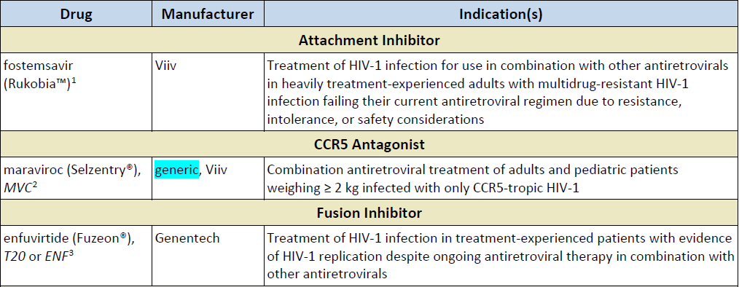
HIV - AIDS

Slide 82
HIV - AIDS

Slide 83
HIV - AIDS

Slide 84
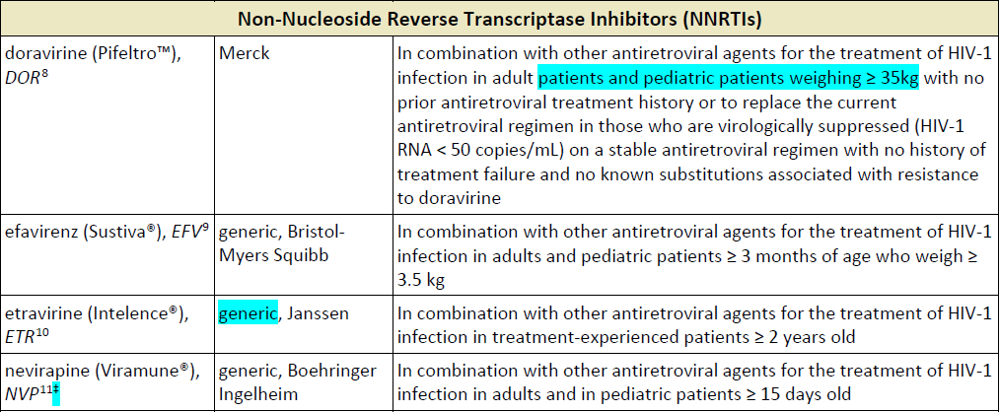
HIV - AIDS

Slide 85
HIV - AIDS
(continued)

Slide 86
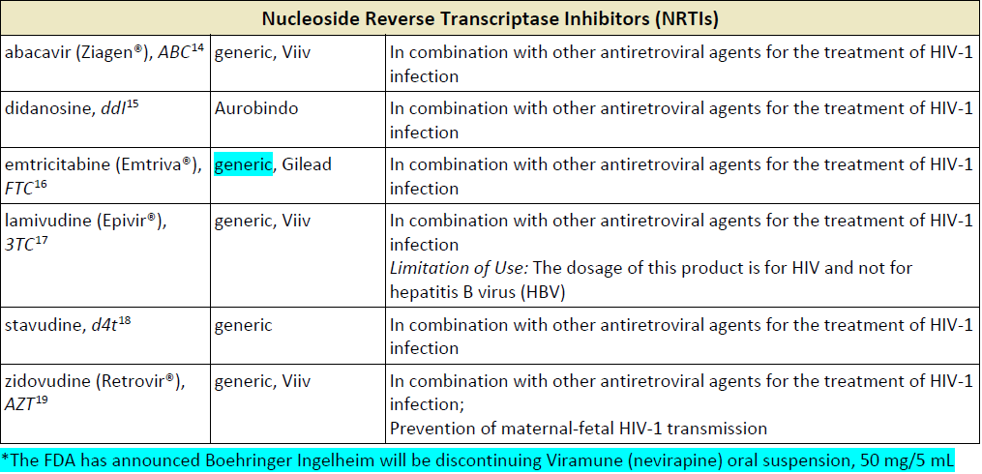
HIV - AIDS

Slide 87
HIV - AIDS

Slide 88
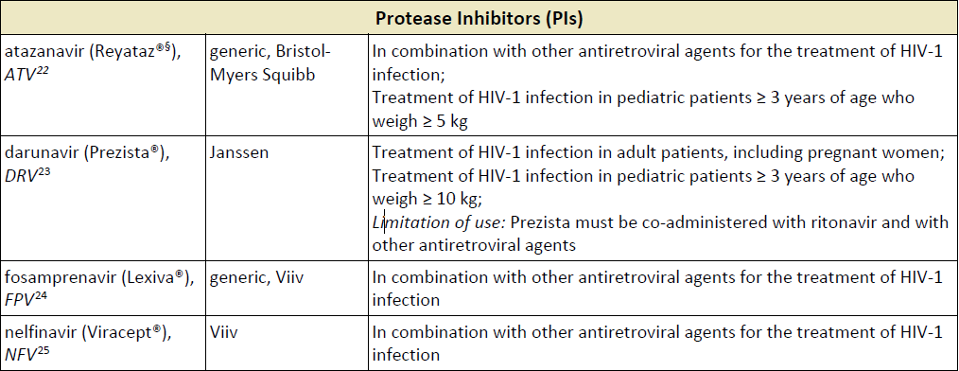
HIV - AIDS

Slide 89
HIV - AIDS
continued

Slide 90
HIV - AIDS

Slide 91
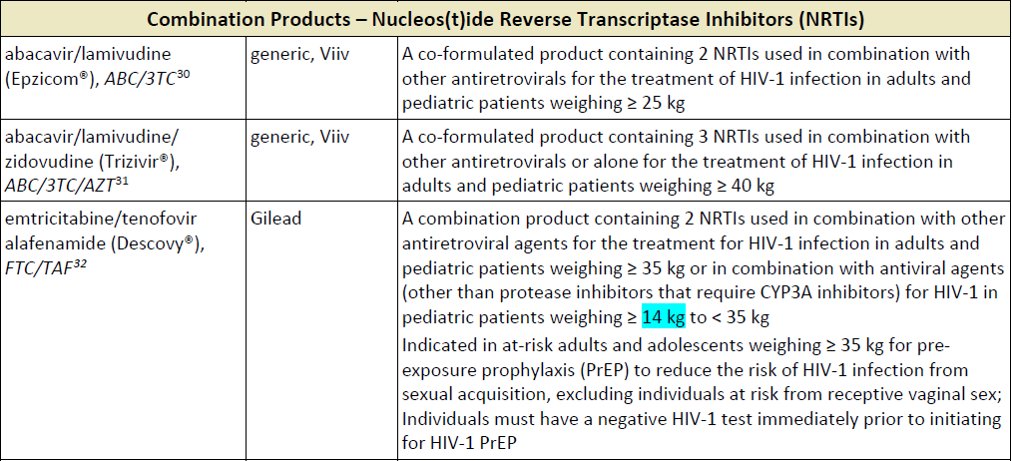
HIV - AIDS

Slide 92
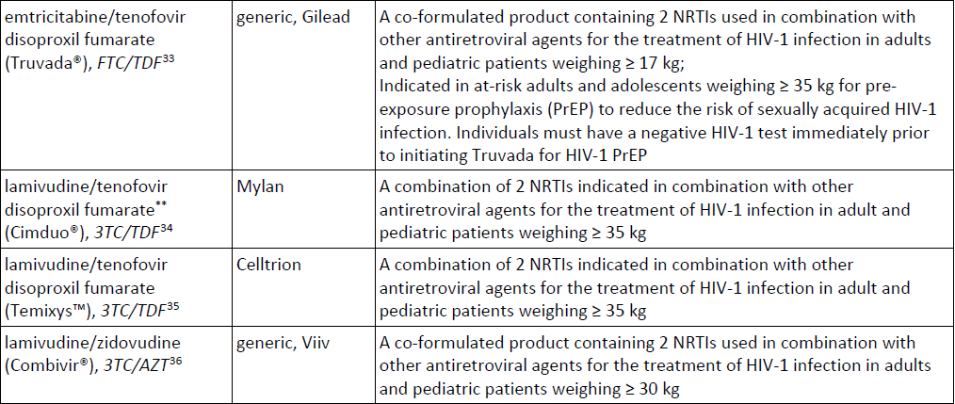
HIV - AIDS
(continued)

Slide 93
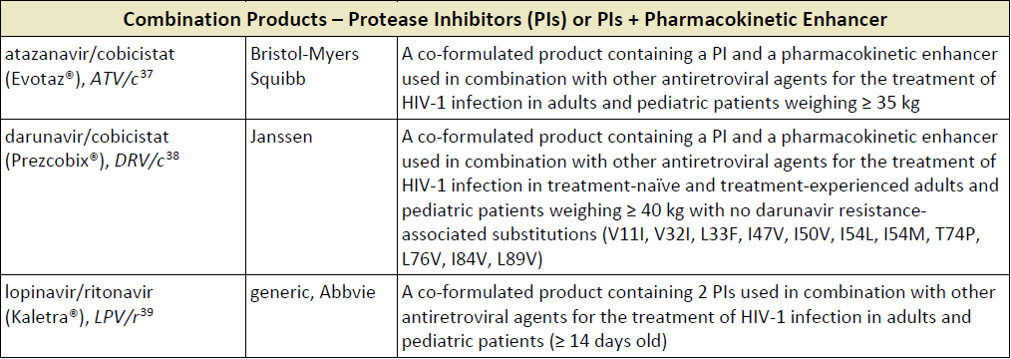
HIV - AIDS

Slide 94
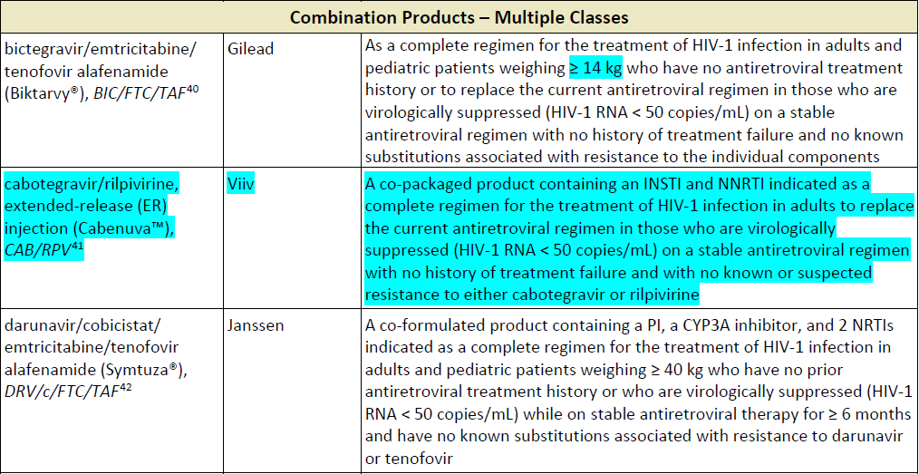
HIV - AIDS

Slide 95
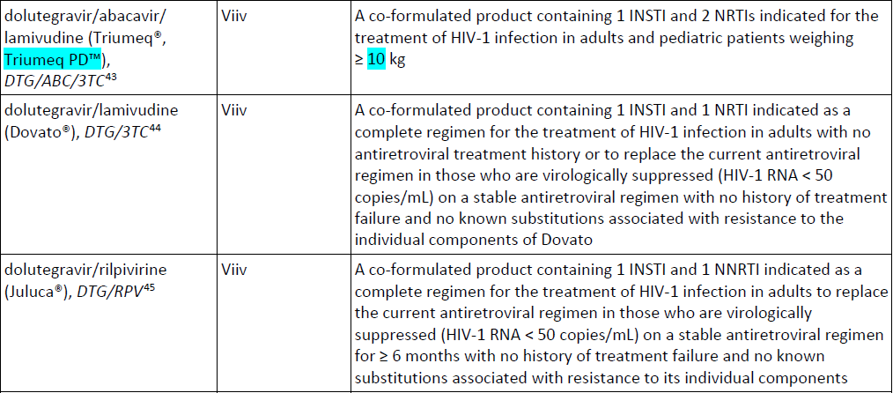
HIV - AIDS

Slide 96
HIV - AIDS

Slide 97
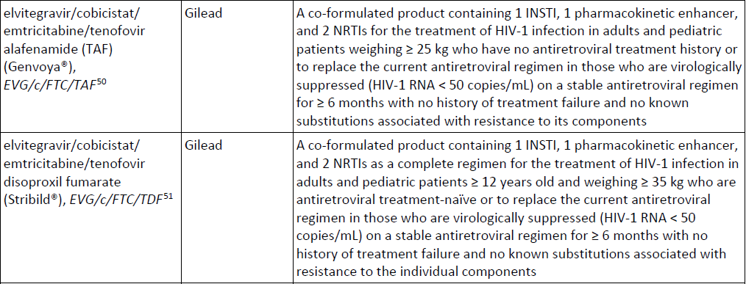
HIV - AIDS

Slide 98
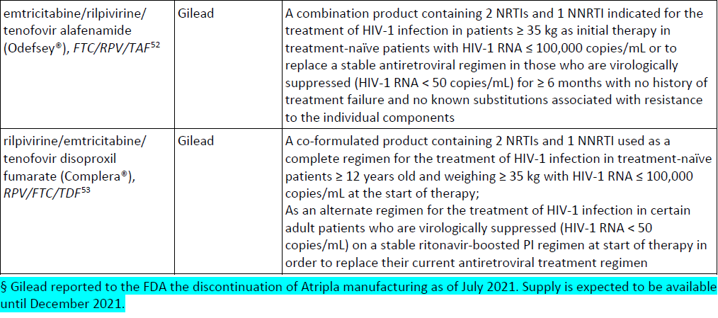
HIV - AIDS

Slide 99
HIV - AIDS
It is estimated that there were approximately 38 million people living with HIV by the end of 2020 , with 73% of adults and 54% of children receiving antiretroviral therapy (ART) globally
Newly infected HIV patients dropped from 3.4 million to 1.7 million from 1996 to 2019, as well as a decline in the number of children acquiring HIV by 52% from 2010 to 2019
In 2020, The Joint United Nations Programme on HIV/AIDS UNAIDS intensified their targets for 2025
Goals include the 95-95-95 treatment target: 95% of people living with HIV are aware of their status, 95% of these patients are receiving treatment, and 95% of them have achieved viral suppression
Additionally, they seek to achieve 95% of women have access to HIV and sexual and reproductive health services, 95% of coverage services to eliminate vertical transmission, and 95% use of combination prevention

Slide 100
HIV - AIDS
Prevention of maternal-fetal HIV transmission has also continued to improve worldwide
All guidelines advise initiating antiretroviral therapy regardless of CD4 cell counts in HIV-infected individuals who are prepared to commit to the regimen
Viral suppression requires multidrug therapy involving 2 or more antiretroviral subclasses
There are several established regimens that are successful when used in the appropriate stage of a patient’s HIV infection

Slide 101
HIV - AIDS
All currently recommended treatment regimens for treatment-naïve individuals utilize drugs from the following classes:
nucleos(t)ide reverse transcriptase inhibitors (NRTIs)
non-nucleoside reverse transcriptase inhibitors (NNRTIs)
protease inhibitors (PIs)
integrase strand transfer inhibitors (INSTIs)
INSTI-based regimens are now considered first-line therapy for treatment-naïve patients in current guidelines
NNRTI-based regimens have a low threshold for the development of resistance

Slide 102
HIV - AIDS
PI-based regimens have more virologic potency and durability, as well as higher barriers to resistance compared to other regimens
However, PIs have more concerning adverse event profiles
CCR5-based regimens are also effective but require expensive coreceptor tropism assays prior to use and need more studies with other NRTIs
In patients who are experiencing treatment failure, HIV RNA genotypic drug-resistance testing and next generation sequencing genotypic resistance assays are available
A monoclonal antibody, ibalizumab-uiyk (Trogarzo), and an attachment inhibitor, fostemsavir (Rukobia), are indicated in heavily treatment-experienced adults with multidrug resistant HIV-1 infection who are failing their current antiretroviral regimens

Slide 103
HIV - AIDS
For Individuals at high risk to contract HIV, pre-exposure pharmacologic prophylaxis (PrEP) includes emtricitabine/tenofovir disoproxil fumarate (Truvada) and emtricitabine/tenofovir alafenamide (Descovy), cabotegravir (Vocabria; short-term use), and cabotegravir extended-release (Apretude)

Slide 104
Movement Disorders

Slide 105
Movement Disorders

Slide 106
Movement Disorders
There are various types of movement disorders, including parkinsonism, tremor, dystonia, dyskinesia, tics, chorea, and other involuntary movements
Chorea, an abnormal involuntary twisting or writhing movement, is a characteristic feature of Huntington’s disease (HD)
It affects approximately 90% of people with HD (over 35,000 people in the US)
The 2012 American Academy of Neurology (AAN) guidelines recommend tetrabenazine, amantadine, or riluzole for chorea associated with HD
Austedo has not been addressed in these clinical practice guidelines; however, an update to the guidelines is in progress
Austedo and tetrabenazine have both demonstrated superiority over placebo but have not been compared head-to-head in controlled trials

Slide 107
Movement Disorders
Both tetrabenazine and Austedo carry a boxed warning for depression and suicidality
Tardive dyskinesia (TD) consists of involuntary movements of the tongue, lips, face, trunk, and extremities
TD generally occurs after long-term treatment with dopamine antagonists
It occurs at a rate of approximately 4% to 8% per year in adult patients treated with a first-generation antipsychotics, which appears to be about 3 times the rate that has been observed with second-generation antipsychotics
In 2020, the American Psychiatric Association (APA) updated their guidelines for the treatment of schizophrenia
They recommend that patients who have moderate to severe or disabling TD related to antipsychotic therapy be treated with Austedo, tetrabenazine, or Ingrezza (1B)

Slide 108
Movement Disorders
They state that Austedo or Ingrezza is preferred over tetrabenazine due to the data supporting their use
Patients with mild TD can also be considered for treatment with a VMAT2 inhibitor following an assessment of several factors
Ingrezza and Austedo have demonstrated superiority over placebo in key clinical trials, but they have not been compared to each other or to other treatment strategies for TD

Slide 109
Movement Disorders
The International Parkinson and Movement Disorder Society (MDS) commissioned an evidence-based review on treatments for Huntington’s disease, and results were published in early 2022
Using the Grading of Recommendations Assessment, Development, and Evaluation (GRADE) approach, the group appraised 22 randomized controlled trials of 17 interventions targeting several predetermined questions
High quality data were limited. Relevant to pharmacotherapeutic treatments in this class, the group found that both deutetrabenazine and tetrabenazine are likely efficacious for chorea
They also concluded that deutetrabenazine is likely efficacious for motor impairment, while tetrabenazine is unlikely efficacious

Slide 110
Movement Disorders
MDS evidence-based review continued:
Similarly, deutetrabenazine is likely efficacious for dystonia, but data were too limited regarding tetrabenazine
Deutetrabenazine and tetrabenazine were determined unlikely efficacious in functional capacity improvement as well as gait and balance. Notably, both agents are only approved for the treatment of chorea associated with Huntington’s disease
Regarding safety of interventions, the group categorized deutetrabenazine as unlikely harmful while tetrabenazine was considered likely harmful

Slide 111
Phosphate Binders

Slide 112
Phosphate Binders

Slide 113
Phosphate Binders
Chronic kidney disease (CKD) affects approximately 37 million Americans in the United States (US)
As kidney function deteriorates, the ability to eliminate phosphorus declines, resulting in hyperphosphatemia, one of the complications of CKD
Elevated levels of phosphorus inhibit the conversion of 24-hydroxyvitamin D to 1,25-dihydroxyvitamin D (calcitriol)
The reduction in calcitriol decreases intestinal absorption of calcium and eventually leads to hypocalcemia

Slide 114
Phosphate Binders
In end stage renal disease (ESRD), patients are at risk for several complications of hyperphosphatemia, including the development of renal bone disease and extraosseous calcifications of soft tissue and vasculature
Hyperphosphatemia (> 6.5 mg/dL) is also associated with increased risk of death
All phosphate binders are considered effective in reducing serum phosphate levels, and treatment guidelines do not strongly prefer one agent in this class over another for adults

Slide 115
Phosphate Binders
The National Kidney Foundation (NKF) 2017 Clinical Practice Guideline for the Diagnosis, Evaluation, Prevention, and Treatment of Chronic Kidney Disease – Mineral and Bone Disorder (CKD-MBD) under The Kidney Disease: Improving Global Outcomes (KDIGO) foundation advise that treatment of hyperphosphatemia includes the reduction of dietary phosphorus, phosphate binding therapy, and removal of phosphorus by dialysis and should consider serial phosphate, calcium, and PTH levels
Although the recommendation is not graded, they advise basing decisions regarding phosphate-lowering treatment on progressively or persistently elevated serum phosphate rather than to prevent hyperphosphatemia

Slide 116
Hereditary Angioedema Agents

Slide 117
Hereditary Angioedema Agents

Slide 118
Hereditary Angioedema Agents

Slide 119
Hereditary Angioedema Agents
Hereditary angioedema (HAE) is a rare, dominant autosomal genetic disorder that affects approximately 6,000 individuals in the US
Patients with HAE have low levels of endogenous or functional C1 esterase inhibitor (C1-INH)
HAE is characterized by recurrent episodes of nonpruritic, nonpitting, subcutaneous (SC) or submucosal edema involving the skin or mucosal tissues of the upper respiratory and gastrointestinal (GI) tracts
Although swelling can resolve spontaneously in several days, without treatment laryngeal edema may be fatal and the pain of GI attacks can be incapacitating

Slide 120
Hereditary Angioedema Agents
Symptoms can begin as early as 2 years of age and persist throughout life with unpredictable severity and frequency of attacks
It is thought that minor trauma and stress can lead to an attack; however, many attacks occur without any apparent trigger
There are 2 types of C1-INH deficient HAE. The most common type (Type I), in which the body does not produce enough C1-INH, occurs in about 85% of patients with the condition
Type II HAE is characterized by the presence of normal or high levels of a dysfunctional C1-INH

Slide 121
Hereditary Angioedema Agents
HAE prophylaxis is needed to reduce potential edema caused by a stressor or procedure likely to precipitate an attack (short-term prophylaxis) or to decrease the number and severity of angioedema attacks (long-term prophylaxis)
The 2020 US Hereditary Angioedema Association (HAEA) guidelines for the management of HAE recommends short-term prophylaxis prior to medical, dental, or surgical procedures
As disease severity may change over time, the need for continued long-term prophylaxis should be assessed periodically. In addition, patients receiving prophylactic therapy should also have access to on-demand treatment for acute attacks
The need for long-term prophylaxis should be made based on attack frequency, attack severity, comorbid conditions, access to treatment, and patient experience and preference

Slide 122
Hereditary Angioedema Agents
Plasma-derived concentrates of human plasma-derived C1-INH (Berinert, Cinryze) and a recombinant analogue of C1-INH (Ruconest) are available as IV injections, and human plasma-derived C1-INH (Haegarda) is available as a subcutaneous injection
Ecallantide (Kalbitor) is a selective inhibitor of the plasma protein, kallikrein, and is administered subcutaneously
Lanadelumab-flyo (Takhzyro) is the second kallikrein inhibitor, but the only monoclonal antibody, and is administered subcutaneously
Berotralstat (Orladeyo) is the third kallikrein inhibitor and is administered orally once daily
Icatibant (Firazyr) is a selective synthetic bradykinin B2 receptor antagonist and is also administered subcutaneously

Slide 123
Immunomodulators, Atopic Dermatitis

Slide 124
Immunomodulators, Atopic Dermatitis

Slide 125
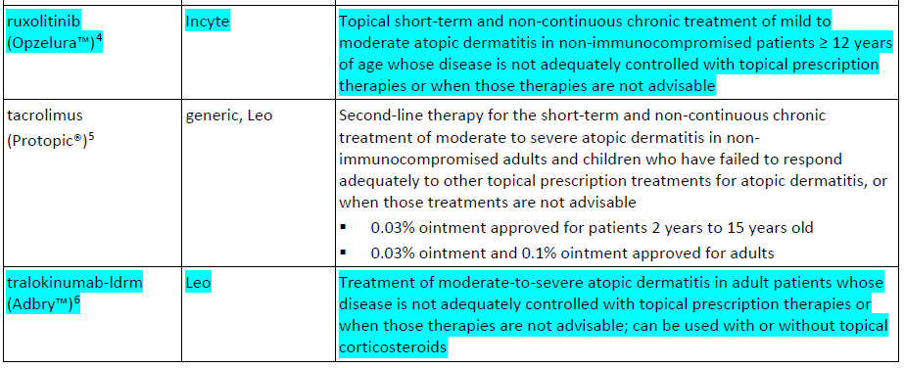
Immunomodulators, Atopic Dermatitis

Slide 126
Immunomodulators, Atopic Dermatitis
Atopic dermatitis (AD) is a chronic, non-contagious, inflammatory disease of the skin resulting from a combination of genetic and environmental factors Approximately 70% of patients diagnosed with AD have a positive family history of atopic diseases
Often referred to as “eczema,” AD affects up to 13% of children and about 7.3% of adults in the US
Although symptoms of AD can develop at any age, it has been estimated that 60% of patients develop symptoms in the first year of life, while 90% develop symptoms before the age of 5 years
AD is characterized by extremely dry, itchy skin on the insides of the elbows, behind the knees, and on the face, hands, and feet

Slide 127
Immunomodulators, Atopic Dermatitis
The American Academy of Dermatology (AAD) guidelines from 2014 state that emollients, topical corticosteroids, and topical calcineurin inhibitors are the standard of care for the treatment of AD
For patients whose eczema is not controlled by topical corticosteroids, or when there is a serious risk of adverse events from topical corticosteroids, topical calcineurin inhibitors should be used
Like the AAD guidelines, the American Academy of Allergy, Asthma, and Immunology (AAAAI) 2012 guidelines state that pimecrolimus and tacrolimus are reasonable treatment options for patients as second-line treatment choices. First-line options include hydration (emollients), moisturizers, and topical corticosteroids
Crisaborole (Eucrisa), dupilumab (Dupixent), ruxolitinib (Opzelura), and tralokinumab-ldrm (Adbry) were not available at the time of the development of these guidelines but may be considered as second-line treatment options for patients with mild, moderate, or severe atopic dermatitis

Slide 128
Immunomodulators, Atopic Dermatitis
Crisaborole (Eucrisa) is a phosphodiesterase 4 (PDE-4) inhibitor.
Dupilumab (Dupixent), a human monoclonal IgG4 antibody, inhibits interleukin-4 (IL-4) and interleukin-13 (IL-13) signaling via binding to the IL-4 receptor alpha subunit found on both complexes, resulting in inhibition of cytokine-induced responses (e.g., proinflammatory cytokines, chemokines, IgE)
Pimecrolimus (Elidel) is a derivative of the macrolactam ascomycin. It binds to the intracellular protein macrophilin-12 (FKBP-12) and inhibits the calcium-dependent phosphatase calcineurin
Ruxolitinib (Opzelura) is a Janus kinase inhibitor that targets the JAK and signal transducer and activator of transcription (STAT) pathway, and may mediate itch response, inflammation, and skin barrier dysfunction associated with AD

Slide 129
Immunomodulators, Atopic Dermatitis
Tacrolimus (Protopic) is a topical macrolactam agent. It exerts its pharmacologic activity by binding to FKBP-12. A complex is then formed which includes calcineurin
Tralokinumab-ldrm (Adbry) is a human monoclonal antibody that is an interleukin-13 antagonist and inhibits the inflammatory response of cytokines, chemokines, and IgE

Slide 130
Immunomodulators, Atopic Dermatitis
Crisaborole (Eucrisa) is indicated for patients ≥ 3 months of age
Pimecrolimus (Elidel) and tacrolimus 0.03% (Protopic) are approved for use in patients ≥ 2 years of age
The safety and efficacy of ruxolitinib (Opzelura) in pediatric patients < 12 years of age have not been established
Safety and efficacy of tralokinumab-ldrm (Adbry) have not been established in pediatric patients (≤ 18 years of age)

Slide 131
Immunomodulators, Atopic Dermatitis
FDA approved Dupixent new indication for the treatment of adult and pediatric patients ages ≥ 12 years old, weighing ≥ 40 kg, with eosinophilic esophagitis. For this indication, it is dosed as 300 mg administered SC once weekly. Received Breakthrough Therapy designation and Priority Review
The FDA has expanded the age range for the Dupixent (atopic dermatitis) indication to the treatment of patients ≥ 6 months old with moderate-to-severe atopic dermatitis whose disease is not adequately controlled with topical prescription therapies or when those therapies are not advisable
Previously, it was indicated for atopic dermatitis patients ≥ 6 years old

Slide 132
New Drug Reviews
Hind Douiki, Pharm.D.

Slide 133
New Products
Camzyos (mavacamten)
Mounjaro (tirzepatide)
Vtama (tapinarof)

Slide 134
Camzyos (mavacamten)
A reversible selective cardiac myosin inhibitor indicated for the treatment of adults with symptomatic New York Heart Association (NYHA) class 2 to class 3 obstructive hypertrophic cardiomyopathy (HCM) to improve functional capacity and symptoms
The recommended starting dose is 5 mg once; allowable subsequent doses with titration are 2.5, 5, 10, or 15 mg once daily
Available as 2.5 mg, 5 mg, 10 mg, 15 mg capsules
Contraindication
Concomitant use with strong CYP2C19 inhibitors or strong CYP3A4 inhibitors
CYP2C19 inducers or moderate to strong CYP3A4 inducers

Slide 135
Camzyos (mavacamten)
Mavacamten is only available through a restricted Risk Evaluation and Mitigation Strategy (REMS) program due to the risk of heart failure
Warnings: boxed warning for risk of heart failure as the agent can cause heart failure due to systolic dysfunction
Mavacamten can cause embryofetal toxicity when given to pregnant females

Slide 136
Camzyos (mavacamten)
Drug Interactions:
strong CYP2C19 or strong CYP3A4 inhibitors
moderate to strong CYP2C19 or moderate to strong CYP3A4 inducers
disopyramide, ranolazine, verapamil with a beta-blocker, or diltiazem with a beta-blocker
Adverse Effects:
dizziness
syncope

Slide 137
Camzyos (mavacamten)
In EXPLORER-HCM, a double-blind, randomized, placebo-controlled, multicenter, global, parallel-group, phase 3 trial, safety and efficacy of mavacamten were evaluated in 251 adult patients
Patients either received mavacamten or placebo in a 1:1 ratio for a median duration of 30 weeks (range, 2 weeks to 40 weeks)
The primary composite outcome was the proportion of patients who achieved either improvement of mixed venous oxygen tension (pVO2) by ≥ 1.5 mL/kg/min plus improvement in NYHA class by at least 1 class reduction or improvement of pVO2 by ≥ 3 mL/kg/min plus no worsening in NYHA class

Slide 138
Camzyos (mavacamten)
Significantly more patients met the primary outcome at week 30 in the mavacamten group compared to the placebo group; 37% versus 17%, respectively, 19.4% difference (95% confidence interval [CI], 8.7 to 30.1; p=0.0005).
Nine patients in total, 7 receiving mavacamten and 2 receiving placebo, exhibited a transient decrease in LVEF to < 50% with 5 patients (3 on mavacamten, 2 on placebo) having protocol-required temporary therapy discontinuation.
In all patients treated with mavacamten, LVEF recovered following dose interruption.
Patients receiving mavacamten had significantly greater improvement in all secondary endpoints (e.g., mean reduction from baseline post-exercise LVOT peak gradient and increases in pVO2, improvement in NYHA class ≥ 1) compared to placebo.

Slide 139
Mounjaro (tirzepatide)
A glucose-dependent insulinotropic polypeptide (GIP) receptor agonist and glucagon-like peptide-1 (GLP-1) receptor agonist indicated as an adjunct to diet and exercise to improve glycemic control in adults with type 2 diabetes mellitus (T2DM).
It is the first antidiabetic agent that targets both GLP-1 and GIP approved by the US Food and Drug Administration (FDA).
Available as Injectable solution in 0.5 mL prefilled, single-dose pens in 2.5 mg, 5 mg, 7.5 mg, 10 mg, 12.5 mg, and 15 mg

Slide 140
Mounjaro (tirzepatide)
The starting dose is 2.5 mg SC once weekly to the abdomen, thigh, or upper arm without regard to meals; dose may be increased to 5 mg SC after 4 weeks, with additional increases in 2.5 mg every 4 week increments to a maximum dose of 15 mg once weekly.
Contraindications include known serious hypersensitivity to any component of the product.
Tirzepatide is also contraindicated in patients with a personal or family history of medullary thyroid carcinoma (MTC) or with multiple endocrine neoplasia syndrome type 2 (MEN 2).

Slide 141
Mounjaro (tirzepatide)
Carries Boxed Warning for risk of thyroid C-cell tumors
Additional warnings
Pancreatitis
Hypoglycemia with Concomitant Use of Insulin Secretagogues or Insulin:
Hypersensitivity Reactions
Acute Kidney Injury
Severe Gastrointestinal Disease
Diabetic Retinopathy Complications in Patients with a History of Diabetic Retinopathy
Acute Gallbladder Disease

Slide 142
Mounjaro (tirzepatide)
Adverse reactions:
nausea constipation
diarrhea dyspepsia
decreased appetite abdominal pain
vomiting

Slide 143
Mounjaro (tirzepatide)
The phase 3 SURPASS clinical study program evaluated once weekly SC tirzepatide in adults with uncontrolled T2DM. The primary endpoint in all studies reviewed below was the mean change in hemoglobin A1c (HbA1c) from baseline
The SURPASS-1 trial was a 40-week, double-blind, placebo-controlled study that assessed tirzepatide in 478 adult patients with uncontrolled T2DM with diet and exercise
At week 40, all tirzepatide doses were superior to placebo based on mean change from baseline in HbA1c (-1.87%, -1.89%, and -2.07% versus +0.04% with tirzepatide 5 mg, 10 mg, and 15 mg versus placebo, respectively; all p<0.0001)
More patients who received tirzepatide compared to placebo achieved a HbA1c < 7% (87%, 92%, and 88% versus 19%, respectively; all p<0.001)

Slide 144
Mounjaro (tirzepatide)
The SURPASS-2 trial was a 40-week, open-label study that evaluated tirzepatide in 1,879 adult patients with inadequately controlled T2DM while on metformin (≥ 1,500 mg/day)
At week 40, all tirzepatide doses were superior to semaglutide based on the mean change in HbA1C from baseline (-2.01%, -2.24%, and -2.3% versus -1.86% with tirzepatide 5 mg, 10 mg, and 15 mg versus semaglutide, respectively; p=0.02, p<0.001, and p<0.001, respectively for tirzepatide versus semaglutide)
More patients who received tirzepatide compared to semaglutide achieved an HbA1c < 7% (82%, 86%, and 86% versus 79%, respectively; p=not reported [NR], p<0.05, and p<0.05, respectively) and HbA1c < 5.7% (27%, 40%, and 46%, versus 19%, respectively; p=NR, p<0.001, p<0.001, respectively)

Slide 145
Mounjaro (tirzepatide)
The SURPASS-3 trial was an open-label, parallel-group study that evaluated tirzepatide in 1,444 adult patients with inadequately controlled T2DM on stable treatment with metformin alone or in combination with an SGLT2 inhibitor
At week 52, in the modified intent-to-treat group (mITT; n=1,437), all doses of tirzepatide demonstrated non-inferiority to insulin degludec based on the mean change in HbA1c from baseline (-1.93%, -2.2%, and -2.37% versus -1.34%, with tirzepatide 5 mg, 10 mg, and 15 mg versus insulin degludec, respectively; non-inferiority margin of 0.3% was met)
Significantly more patients in the tirzepatide groups achieved an HbA1c < 7% compared to those in the insulin degludec group (82%, 90%, and 93% versus 61%, respectively; all p<0.0001)

Slide 146
Mounjaro (tirzepatide)
The SURPASS-4 trial (NCT03730662) was an open-label trial, parallel-group study. It enrolled 1,995 adult patients with inadequately controlled T2DM on metformin, a sulfonylurea, and/or a SGLT2 inhibitor and at increased cardiovascular (CV) risk
At week 52, in the mITT population, tirzepatide 5 mg, 10 mg, and 15 mg significantly reduced HbA1c from baseline compared to insulin glargine (-2.24%, -2.43%, and -2.58% versus -1.44% with tirzepatide 5 mg, 10 mg, and 15 mg versus insulin glargine, respectively; all p<0.001)
In addition, significantly more patients treated with tirzepatide achieved a HbA1c < 7% (81%, 88%, and 91% versus 51%, respectively; all p<0.0001). The change in fasting serum glucose was similar across all groups

Slide 147
Mounjaro (tirzepatide)
The SURPASS-5 trial evaluated tirzepatide as an addition to insulin glargine in 475 adult patients with inadequately controlled T2DM
At 40 weeks, the addition of tirzepatide led to a mean change in HbA1c from baseline of -2.11%, -2.4%, and -2.34% with tirzepatide 5 mg, 10 mg, and 15 mg, respectively, compared to -0.86% with placebo added to insulin glargine (all p<0.001)
The proportion of patients who achieved a HbA1c < 7% was 87.3%, 89.6%, and 84.7% with tirzepatide 5 mg, 10 mg, and 15 mg, respectively, compared to 34.5% with placebo (all p<0.001)
Changes in fasting serum glucose from baseline were -58.2 mg/dL, -64 mg/dL, and 62.6 mg/dL with the tirzepatide doses, respectively, compared to -39.2 mg/dL with placebo

Slide 148
Vtama (tapinarof)
An aryl hydrocarbon receptor agonist indicated for the topical treatment of plaque psoriasis in adults
Available as a 1% 60 gram tube
A thin layer of tapinarof cream should be applied once daily to affected area(s)
There are no contraindications, or warnings with use of tapinarof cream
Adverse effects:
Folliculitis Headache
Nasopharyngitis Pruritus
Contact dermatitis Influenza

Slide 149
Vtama (tapinarof)
The safety and efficacy of tapinarof 1% cream was evaluated in two identical phase 3 multicenter, randomized, vehicle-controlled trials (PSOARING 1 and PSOARING 2)
510 and 515 patients being enrolled, respectively in PSOARING 1 and 2
Patients were randomly assigned 2:1 to tapinarof 1% cream or vehicle cream once daily for 12 weeks
Physician’s Global Assessment response occurred more frequently in patients receiving tapinarof compared to vehicle in both PSOARING 1 and PSOARING 2 (35.4% versus 6% and 40.2% versus 6.3%, respectively)
In addition, the secondary efficacy endpoint of ≥ 75% reduction in the Psoriasis Area and Severity Index score (PASI 75) occurred more frequently in patients receiving tapinarof compared to vehicle in both PSOARING 1 and PSOARING 2 (36.1% versus 10.2% and 47.6% versus 6.9%, respectively; in both trials)

Slide 150
Conflict of Interest Training
Susan Russo, Deputy General Counsel
Office of the General Counsel
AHCCCS

Slide 151
Agenda
Applicable Laws & Policies
Intent
Examples
Procedures
Questions

Slide 152
Executive Order 2018-06
1.) The Arizona Health Care Cost Containment System (AHCCCS) shall annually provide mandatory conflict of interest training to all members of the Pharmacy and Therapeutics Committee.
Notes:
In 2018, Governor Ducey issued an executive order that made certain requirements for AHCCCS and the P&T Committee. The first requirement is why we are doing this training today – AHCCCS must provide a conflict of interest training to P&T Committee members.

Slide 153
Executive Order 2018-06
2.) AHCCCS shall publicly post all disclosure forms for all members of the Pharmacy and Therapeutics Committee must abstain from vote if conflict of interest exists.
Notes:
The second requirement is related to disclosures. P&T Committee members must disclose potential conflicts of interest via a disclosure form, and AHCCCS must publicly post those disclosure forms. And we will get into some of the specifics around this requirement when we look at the disclosure form in a few slides. You may also notice that there is a little word jumble in the end of this one, but it takes us to Requirement #3.

Slide 154
Executive Order 2018-06
3.) In accordance with Arizona Revised Statutes Title 38 Chapter 3 Article 8, any member of the Pharmacy and Therapeutics Committee who has a conflict on any agenda item shall abstain from participating in the discussion of and voting on that agenda item.
Notes:
#3 requires any P&T Committee member who has a conflict on an agenda item to abstain from discussion AND voting on that item. This requirement sets the first potential outcome of a conflict of interest: some conflicts will only result in staying out of the matter all together.

Slide 155
Executive Order 2018-06
4.) AHCCCS shall adopt a policy requiring any individual providing in-person or written testimony at meetings of the Pharmacy and Therapeutics Committee to disclose whether they represent a pharmaceutical or medical device company and whether they have received any form of payment or compensation from a pharmaceutical or medical device company.
Notes:
And making sure we note all the requirements from the order, going back to #4 – Disclosure is also required for anyone providing oral or written testimony at P&T Committee meetings.

Slide 156
Executive Order 2018-06
5.) AHCCCS shall review publicly available data on payments by pharmaceutical and medical device companies to physicians to determine an appropriate threshold above which a person shall be disqualified from serving on the Pharmacy and Therapeutics Committee.
Notes:
Skipping from the third requirement to the fifth now, we see the other potential outcome of a conflict of interest.
When a P&T Committee member or potential member receives payments that are above a certain amount, that person cannot serve on the Committee. AHCCCS’s responsibility is to determine what that amount is.

Slide 157
AHCCCS Contractor Operations Manual Ch. 111
Section III(B)(4)
Committee members shall not:
a. Be employed by, subcontract with, or directly or indirectly represent a pharmaceutical manufacturer,
b. Be employed by, subcontract with, or directly or indirectly represent a Pharmacy Benefits Management (PBM) company, or
c. Receive payments or compensation from the pharmaceutical industry in excess of the CMS Open Payments database US Mean, including the Specialty Mean, if available, for the most recent year.
Notes:
Through the executive order, AHCCCS was required to put these items into policy, which we’ve captured in ACOM 111. In Section III(B)(4), we set forth what level of conflict rises to that level of disqualification. So, if any one of these conditions is true, then a person cannot be a Committee member. (Go through list)
And we will discuss examples applying these conditions in a few slides.

Slide 158
AHCCCS Contractor Operations Manual Ch. 111: Appendix A Disclosure Form
Disclosure:
Any financial relationship, affiliation, or other relationship
May include, but is not limited to: being employed by, being on retainer, having research or honoraria paid by, or receiving other forms of remuneration
With any organization
That may have a direct or indirect interest in business that may be considered by the Committee
Within the past 24 months
Notes:
AHCCCS has also added some clarification of what must be disclosed, what may be a conflict of interest. (Go through list). And again, we will be discussing some examples to apply these requirements shortly.

Slide 159
Arizona Statutes for All Public Officers
A.R.S. § 38-503 requires disclosure and abstention as set forth in Executive Order 2018-06. It pertains to a “substantial interest in” a contract, sale, purchase or service to the public agency.
Applies to officers and their “relatives”: spouse, child, child's child, parent, grandparent, brother or sister of the whole or half blood and their spouses and the parent, brother, sister or child of a spouse.
A.R.S. § 38-504
(A) No representation, for compensation, any person or entity to the Committee while serving or for one year afterward.
(B) No disclosure or use, for profit, of confidential information obtained while on the committee or for two years afterward.
(C) No use of Committee member status to “secure any valuable thing or valuable benefit” if it “is of such character as to manifest a substantial and improper influence on” duties as a committee member.
Notes:
The Executive Order and the AHCCCS policy stem from Arizona laws that apply to all public officers, which includes you as Committee members. First, 38-503 discusses disclosure and abstaining from situations where a conflict of interest arises. So, it’s the more general version of what we have discussed more specifically.
ARS 38-504 discusses conflicts both during and following public service. (Go through list).

Slide 160
Integrity, Impartiality and Financial Interests
Are there incentives to approve drugs that do not meet criteria?
Financial relationships can influence decisions on drug coverage that should be made based on empirical data.
Covered drugs should be safe, effective, clinically appropriate, and the most cost-effective
Minimizing financial interests in the decision-making process helps ensure impartiality in the development of the Drug List, maintaining the integrity of pharmaceutical coverage.
Notes:
So why do all of these rules exist? The primary question in determining if there is a conflict of interest is (Read slide)

Slide 161
Examples
Scenario: The Committee is discussing whether it should delete Pneumovax from the Drug List because of reported correlations with Guillain-Barre Syndrome.
Example 1: You own stock in Merck. Does it matter how much Pfizer stock you own? Is it on your disclosure form?
Example 2: You’re a physician who prefers Prevnar to Pneumovax, or vice versa.
Example 3: You’re a paid consultant on Prevnar (or Pneumovax).
Example 4: Your spouse is a paid consultant on Pneumovax.
Example 5: Your cousin’s spouse is a Pfizer employee.
Notes:
Let’s consider a scenario (read). (Example 1). If you have answers or thoughts, go ahead and speak up or you can also use the chat box. (Ownership in stock needs to be included on the disclosure form. How much stock you own is important: the amount of money you make might mean the difference between abstaining and disqualification).
(Example 2: A preference for one or the other alone is not a conflict. Many of you surely have professional preferences based on your experiences with your patients. Has money influenced that preference? Or is it based on experience?)
(Example 3: Now financial interests are definitely in play; and it’s in play on both sides. A Prevnar consultant would likely benefit from a decision that would harm a competitor. In addition, are you an employee of a pharmaceutical company?)
(Example 4: For this one, let’s circle back to the previous slides. Your spouse is now the paid consultant and clearly has a financial interest. Under the conflict of interest laws in Arizona, the financial interest of a public officer’s spouse is also the financial interest of the public officer. Your financial interests are not separated.)
(Example 5: Now we have a much more distant relationship between you and who is benefitting financially. Cousins are not included in the statutory definition of relatives. And so, at this point, this would likely not be considered a conflict of interest, though there may be additional details that could further complicate the question.)

Slide 162
More Examples
What are subcontracts?
Consulting? Honoraria? Licensing/royalty fees?
If you speak at a continuing education program about a drug manufactured by the program’s sponsor, do you directly or indirectly represent the pharmaceutical manufacturer?
If you sell your stock in Pfizer, can you now vote on the inclusion/exclusion of Pfizer’s products from the Drug List?
Notes:
Subcontracts are a very broad term. A contract is simply an agreement. It does not need to be in writing to be a contract. Also, all of the items listed here – consulting fees, honoraria, royalty fees are used in the development of the threshold financial interest.
What does everyone think about the next bullet point? Who wants to give their opinion?
And the last bullet point?

Slide 163
Disclosure Procedures
Before a Committee member participates in their first Committee meeting, Committee members shall submit the completed Conflict of Interest Disclosure Form and disclose any potential conflicts of interest with respect to their participation in Committee business.
Committee members shall update their Conflict of Interest Disclosure Form no less than annually from the date of first completion, and additionally no later than 30 calendar days from any change to the information in the existing Conflict of Interest Disclosure Form. The form shall be submitted to AHCCCS at AHCCCSPharmacyDept@azahcccs.gov.
Committee must consider disclosure forms. Committee members must abstain from votes when there is a potential conflict of interest.
Notes:
Now what do each of you, as Committee members, need to do with this information? First, Committee members must submit the disclosure form before service begins. Committee members must also update the disclosure form each year, whether there are changes or not, and no later than 30 calendar days within any change.
And finally, the Committee must consider the forms you each submit. And each member must not abstain even when there is a potential conflict of interest.

Slide 164
Susan Russo, Deputy General Counsel
Notes:
Any questions that may come up after today’s presentation can be directed to Lauren Prole.

Slide 165
Executive Session
Returning around 3:30pm

Slide 166
Public Therapeutic Class Votes

Slide 167
Request to add Ella(Ulipristal) to the AHCCCS Drug List

Slide 168
P&T Meeting Dates
Future Meeting Date: January 25, 2023; May 23, 2023

