Slide 1
Valle del sol's integrated school based services
& the osborn elementary school district

Slide 2
Vds integrated school based services
Valle del Sol inspires positive change by investing in human services to strengthen families with tools and skills for self-sufficiency and by building the next generation of leaders.
Notes:
Introduce Selves – Caitlin & Catherine, credential, role, length of time at Valle
Talk about Valle's 40 year history, what we do as a Federally Qualified Health Center
School Based Services started 4.5 years ago to bring services where kids and families were.
Started with 3 schools and now will be in 50 this school year.

Slide 3
Vds integrated school based services
Value & Commitment to Creating Trust and Systemic Change
Hands-On Experience with Classroom Management
3 Levels of Partnership Available to Each School
Access to All of Valle's Integrated Healthcare Services
Professional Development & Direct Support on Campus
Notes:
Describe these components –
Our 3 levels
Each level gets all 4 components
EXAMPLES
Access to All services – we connect all children and families to services that suit their clinical needs.
Value & Commitment – we realize that there is not immediate trust in healthcare, we're there to build and grow trust with the families but also the school. Anecdote about schools asking us every year if we're staying on board
Hands On Experience – we engage in learning classroom and group management techniques and practice, like Playworks and are starting the Neurosequential model for educators. We also run intensive groups during school breaks in school settings – what a learning curve!
Professional Development & Direct Support – no matter what level of care we offer direct support on campus to the best of our abilities and in accordance with the limitations and requests of the school. We also offer PD for staff to help training and learning on dx, health, trauma, and self care & compassion fatigue

Slide 4
Why Osborn is special
Multiple A+ Schools
Title I
Spanish Dual Language Programs 20+ years
FoodCorps + Nutrition Department
Highly accredited and recognized teachers
Employees children attend our schools
A small district

Slide 5
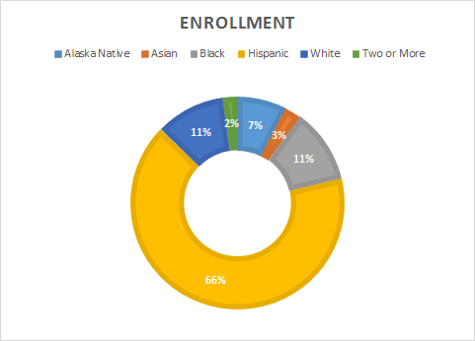
Osborn school district
K-8 Schools
Enrollment: 2508
Free: 100%
Annual Mobility rate: 30%

Slide 6
Vds on campus support
“Parents are not as intimidated by mental health services out of their child’s school and comfortable receiving services or intakes at the school."
– Fabiola Marquez, School Psychologist,
Clarendon Elementary School
Navigating Healthcare & Resources
Trust and Relationship Building with Staff and Families
Clinical Screenings & Assessments
Clinical Observations in the Classroom
1:1 Coaching for Students
Parenting Support Workshops
Individual and Family Therapy
Therapy Groups and Skills Groups
CFT's Connecting Families and Teachers Back Together
De-Escalation Support for Students and Staff
Professional Development for Teachers
Intensive Groups During School Breaks
Warm Hand Offs to Office Based Providers
Higher Show Rates for Medical & BH Appts
Notes:
Catherine – talk about what Fabiola shared about how well it's working, what matters about school based health – reference articles if you'd like
Skim through list of services we give?

Slide 7
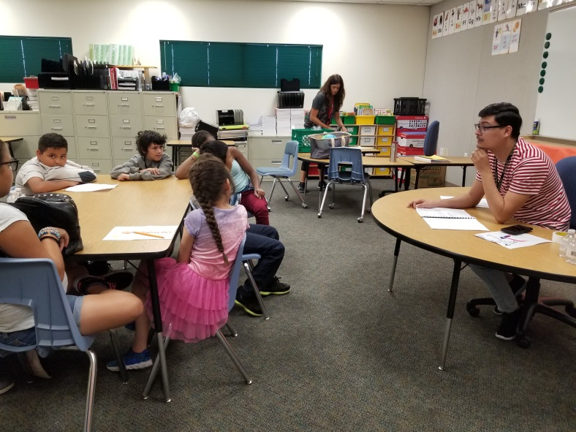
Vds on campus support
This school year alone, Valle is working with more than 200 patients from the Osborn School District, only 2 months into the new school year.
Over the last school year, including school holidays and summer break, Valle has provided more than $614,000 worth of billable services for enrolled students.

Slide 8
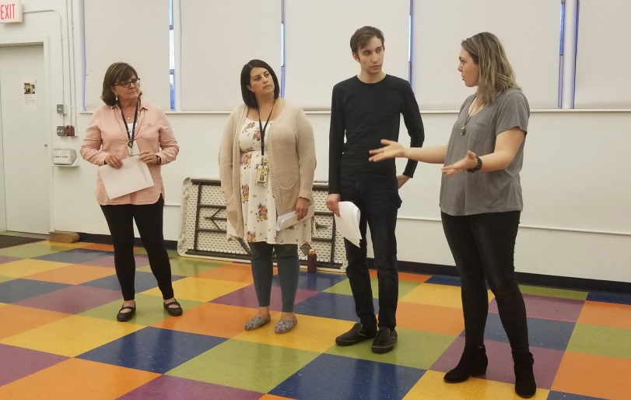
Co-creating systemic change on campus
School Culture
Teachers and Staff
Family
Child
Supporting Teachers & Families with accessible workshops and professional development
Notes:
Caitlin – systems changes, no child lives in their own bubble – in school based services this is how we support children and work in schools.

Slide 9
Conquering barriers and celebrating successes
In the school, staff can quickly identify families that need extra support and then with a swift response from Valle Del Sol, we are able to address concerns from an academic and social emotional standpoint effectively – Fabiola Marquez, School Psychologist,
Clarendon Elementary School
Navigating space & schedules
Supporting children with a variety of insurance coverage, (or lack thereof)
Engaging families who may not be as present
Providing support in crisis events
Establishing consistent communication
Notes:
Catherine – highlights safety Clarendon example and increase in trauma understanding at school
Caitlin – opened opportunities for unique partnerships to increase safety. Discuss E&E briefly. Discuss working with web series briefly.

Slide 10
Thank you!
Any Questions Regarding Valle's School Based Services:
Contact Caitlin Gizler, MAS, LMFT
Director of Integrated School Based Services
CaitlinG@valledelsol.com
602-258-6797
Any Questions Regarding Osborn Elementary School District:
Contact Melinda Riddle
Behavior Intervention Specialist
Mriddle@osbornsd.org
602-707-2319

