Slide 1
MCO/Health Plan Report Cards
Jamie Robin, QI Manager

Slide 2
Current Online Report Card
Only references Acute Lines of Business
Outdated and overwhelming visuals
Target audience not clearly identified
Includes Business Operations, CAHPS Survey, and Performance Measure reporting elements

Slide 3
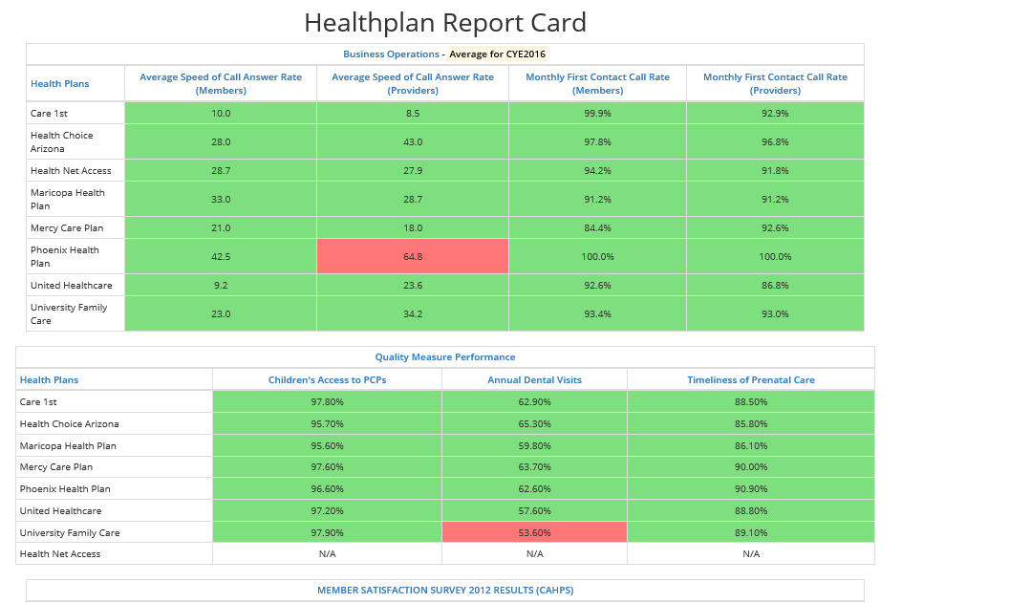
Current On Line Report Card

Slide 4
Updated Online Report Card
Includes other lines of business:
CMDP, ALTCS E/PD, ALTCS DD, and RBHA
Member-centric focus
Updated visuals and formatting to enhance appearance and overall appeal
Similar reporting elements with expanded performance measures incorporated

Slide 5
Updated Online Report Card
Includes new Resources/Links section
Will provide easier access to specific plan (line of business) quality related documents
Example includes EQRO reports
Anticipate initial posting October 2017 with formal reviews and approvals to follow
This includes review and approval through CMS

Slide 6
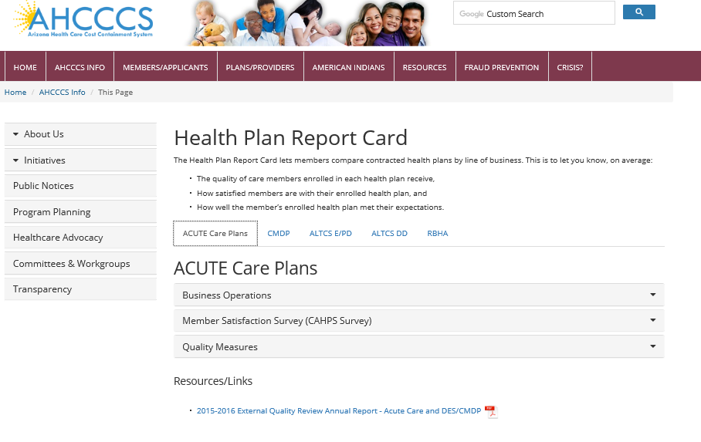
Update Online Report Card

Slide 7
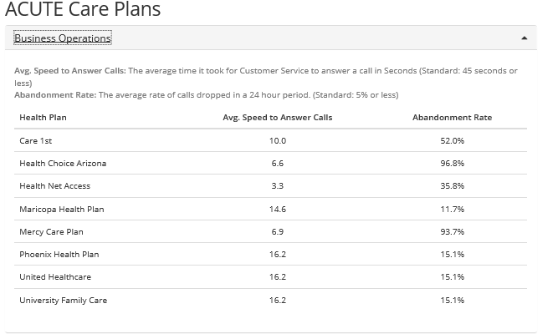
Update Online Report Card

Slide 8
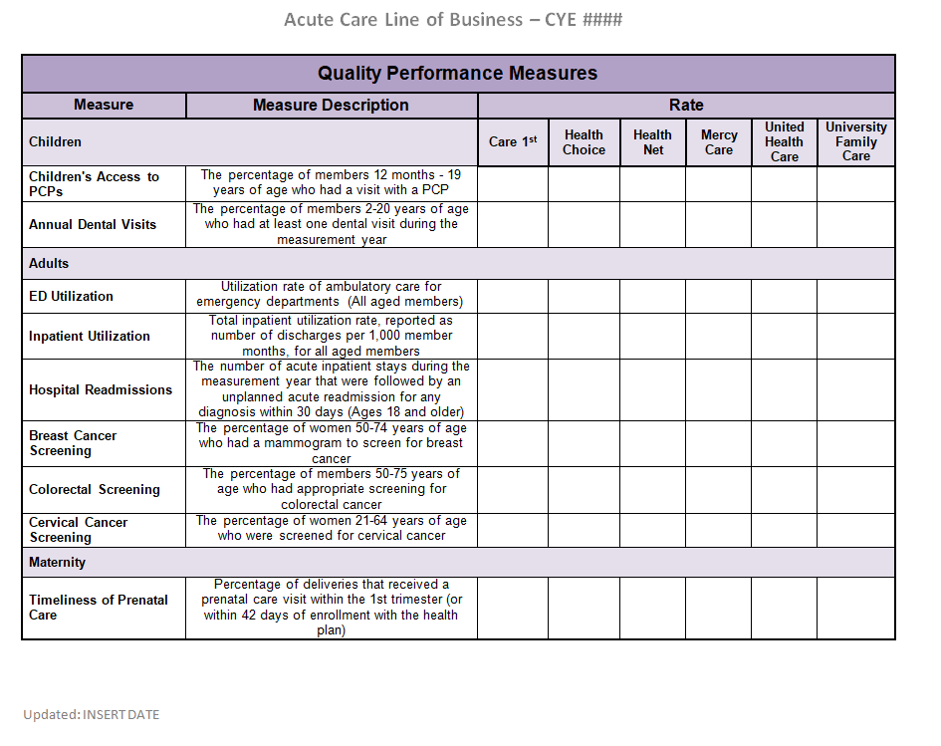
Update Online Report Card

Slide 9
Update Online Report Card
Selected performance measures for each line of business

Slide 10
Questions?

Slide 11
Thank You.

