Slide 1
Welcome!
We’re glad you joined us

Slide 2
Annual AHCCS Reinsurance Workshop RI Contract Year 36

Slide 3
Agenda
Welcome and Introductions
Box A2 Transplant Worksheet
State Only Transplants
RI Manual Changes
New Biological Drugs
DRG Issue 31 Reminder
Website Updates
Transplants
SNF Rates
Reminders
Questions

Slide 4
WELCOME
Emergency procedures
Bathrooms
Breakroom
Fun Fact:
AHCCCS covers 35% of the population

Slide 5
Introductions

Slide 6
Let’s talk about transplant denials…
What are the different ways that your plan handles encounter denials for transplants?

Slide 7
Box A2 on Transplant Worksheet Transplant Encounter Denials
Different scenarios
Scottsdale Pathology billing with POS 11 on all Lab Codes
Mayo Clinic billing modifier 26 on Lab Codes- has been added to PMMIS
Many additional codes daily
Transplant rates are based on Component Rates and cover all AHCCCS Covered Services

Slide 8
Group question
What options does a member have if they lose AHCCCS coverage when they are on the waiting list for a transplant or in the middle of having a transplant?

Slide 9
State Only Transplants Coverage Review
Only for members who lose AHCCCS coverage due to excess income
Created to ensure member does not lose their place on the wait list
Must be determined eligible by DMS
Member must select ST1 or ST2
Member signs agreement for share of cost with the facility
The facility is responsible for getting payment from the member

Slide 10
State Only Transplants Coverage Review
ST1
Member choses all AHCCCS covered services for one year
Transplants that occur past the one year time-frame are not covered
ST2
Member choses to have transplant covered when the organ is available
When organ is available determination is made if the member is AHCCCS eligible, if not transplant only covered under ST2
AMPM being updated

Slide 11
Notes:
Poll Title: How comfortable are you with Reinsurance https://www.polleverywhere.com/multiple_choice_polls/rNjIjoX8ELt5JOn

Slide 12
Notes:
Poll Title: Where do you fit? https://www.polleverywhere.com/multiple_choice_polls/JDnuckSduTp1TXY

Slide 13
Notes:
Poll Title: Would you like to see more training opportunities https://www.polleverywhere.com/multiple_choice_polls/o3A2ygcpKRXpYTI

Slide 14
RI Manual Changes
Biological Drugs
Transplant Section Organization
Other Changes

Slide 15
Biological Drugs
Newly added

Slide 16
Biological Drugs
Term “Generic” replaced with “Biosimiliar“ (page 19)
Beginning 10/1/2017 requests for new biological drugs will not be accepted for Reinsurance purposes.

Slide 17
CHAPTER 7 TRANSPLANTS
Added additional headings and reorganized for clarity
Eligibility section only includes overall information for transplants
Added sections for the following
Contract information
Exclusions and considerations
Added clarifying language regarding Kidney transplants
11+/61+ Stay
Transportation and Lodging
Transplants for members with Medicare

Slide 18
OTHER CHANGES
Removed the verbiage about splitting an encounter on an outlier Mock UB since that no longer applies (pgs. 45 & 31)
Decision letter must accompany a dispute or grievance when submitted (pgs. 34 & 40)
Form type A is eliminated from Regular ALTCS Reinsurance coverage (Form types LMO, LRO, LMW, LRW)
Effective 10/1/18 Regular ALTCS Reinsurance coverage will only include Form type I

Slide 19
Reminder: DRG Issue 31 reminder
. On the UB-04 paper claim form or the 837 institutional submission, the “From” date of service should correspond to the initial admission date of the member. The “Through” date of service reported on the claim should be equal to the first day of the specialty-contract transplant components.

Slide 20
BREAKTIME
15 minutes
Restrooms
This floor
First floor

Slide 21
Reinsurance Website Updates
Removed old Reinsurance Manuals
Added a header “Reinsurance Processing Documents”
Reorganized to categorize forms into sections:
Regular Reinsurance Forms
Catastrophic Forms and Documents
Transplant Forms and Documents
SNF Form
Added Transplant Contract Header

Slide 22
Reinsurance Website Updates
Updated Forms
Edit Resolution Document
Reinsurance Case Creation
Request for Catastrophic Reinsurance
Transplant Worksheet Component Instructions

Slide 23
Team Discussion
Are manual voids allowed during RI pricing lockout?

Slide 24
Team Discussion
No, voids will not be recognized during RI lockout

Slide 25
Team Discussion
When can you submit a replacement to a CRN that is part of a dispute or grievance?

Slide 26
Team Discussion
Encounters for reinsurance claims that have passed the fifteen month deadline and are being adjusted due to a grievance or appeal decision must be submitted and pass all encounter and reinsurance edits within 90 calendar days of the date of the final claim dispute decision or hearing decision, or Director’s decision, or other legal action/proceeding whichever is applicable. Failure to submit the encounter and the decision documentation within this timeframe will result in the loss of any related reinsurance dollars.
(page 40 of Reinsurance manual)

Slide 27
Team Discussion
You are replacing a CRN untimely and the original CRN never associated to the case. What will happen to the CRN?

Slide 28
Team Discussion
The CRN will deny for timeliness edits, H583 or H584.

Slide 29
Transplants
Rate Increase of 2.2%
New Case Types during Contract Year 35
Haploid
Pediatric – PCH (April 1st, 2017)
Adult – Mayo, Honor Health, Banner University Tucson (June 1st, 2017)
VOD – PCH (April 1st, 2017)
New Lung Contract – St. Joseph’s (November 1st, 2016)

Slide 30
Transplants
New Outpatient rates for Mayo only for 61-100 day stay paid at Fee For Service Rates
Tandems/Sequences (stage date changes revert)

Slide 31
Transplants
Kidney
Only Fee For Service and EPDST eligible for Transplant reinsurance
All others are reimbursed through Cap rates
Cannot receive an outlier payment for a case that was not paid with the contract

Slide 32
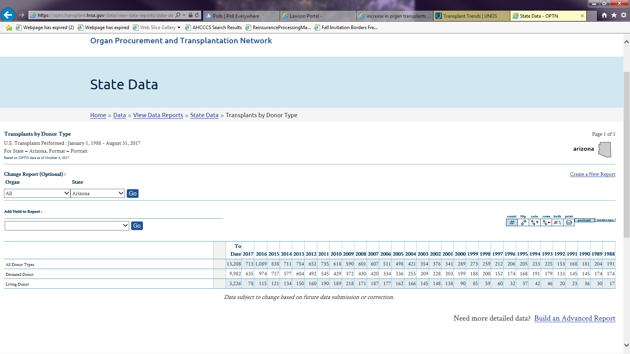
https://optn.transplant.hrsa.gov/data/view-data-reports/state-data/

Slide 33
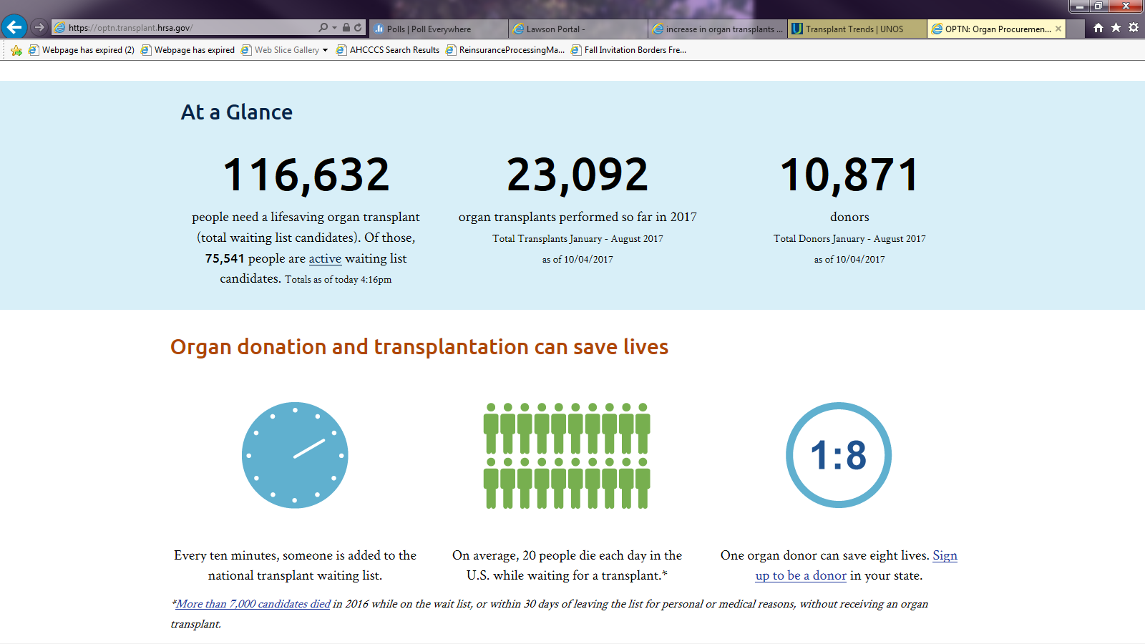
https://optn.transplant.hrsa.gov/

Slide 34
Transplants
Transplant Rebase
AHCCCS is engaging a consultant to review the Transplant Contracts, the scope of those contracts, and the reimbursement methodologies
Contract Amendments should be in place for October 1, 2018

Slide 35
Reminders: SNF Rates
MCO’s are required to submit annually by Oct. 31st of each year-for year 36, deadline for Reinsurance notification is Nov 30th
MCO’s must also submit when rates change
NEW For claims with end dates of service on or after 6/1/18, the 15 month deadline will be implemented on SNF overrides and repricing requests

Slide 36
Reminders
Notwithstanding the denial of reinsurance by AHCCCS, the Contractor is responsible for payment of claims for all services approved by the Contractor.
Reminder to monitor cases that are close to 650,000 and request a Catastrophic case be created
All providers must be registered
2nd reinsurance cycle of Jan will not run

Slide 37
AHCCCS
Health Plans
Hospitals

Slide 38
Questions?

