Slide 1
Annual AHCCCS Reinsurance Workshop RI Contract Year 44
Presented by Lydia Perez, Tracy Thomas, Mercedes Hernandez, and Briana Nunez – Wednesday, October 15th, 2025

Slide 2
Agenda
Welcome and Introductions​
Review Reinsurance Manual Changes for 10/01/2025​
Transplant Contracts Changes effective 10/01/2025​
Discussion​s
Recaps​
Reminders​
Announcement
Questions

Slide 3









Introductions

Slide 4
Reinsurance Manual Changes
Added 6 High-Cost Specialty Drugs to BIO Case Type Covered Services Effective 10/01/2025
Autcatzyl - (obecabtagene autoleucel) is a T cell immunotherapy FDA approved to treat adults with relapsed or refractory B-cell precursor acute lymphoblastic leukemia.
Tecelra (afamitresgene autoleucel) – is an FDA approved genetically modified autologous T Cell immunotherapy used for the treatment of synovial sarcoma.
Tepezza – (teprotumumab-trbw) is an FDA approved medication used to treat thyroid eye disease (TED).
Livmarli - An ileal bile acid transporter inhibitor indicated for the treatment of cholestatic pruritus in patients 3 months of age and older with Alagille syndrome; and the treatment of cholestatic pruritus in patients 12 months of age and older with progressive familial intrahepatic cholestasis.
Vyvgart - A neonatal Fc receptor blocker given as an infusion indicated for the treatment of generalized myasthenia gravis in adult patients who are anti-acetylcholine receptor antibody positive.
Vijoice - A kinase inhibitor indicated for the treatment of adult and pediatric patients 2 years of age and older with severe manifestations of PIK3CA-Related Overgrowth Spectrum (PROS) who require systemic therapy.

Slide 5
Reinsurance Manual Changes
23 additional High-Cost Specialty Drugs are scheduled to be added to the Reinsurance list within the next few weeks. We will keep you posted.

Slide 6
Reinsurance Manual Changes
The High-Cost Specialty Drug List has been removed from the Manual
A new High-Cost Specialty Drug list is now posted on the Reinsurance Website.
You can get to The High-Cost Specialty Drug list through a link to the Reinsurance Website in the Reinsurance Manual.
The High-Cost Specialty Drug list will be updated monthly if there are changes to the list.
Reinsurance Hot News will be used to communicate changes to the High-Cost Specialty Drug list.

Slide 7
Reinsurance Manual Changes
The High-Cost Specialty Drug Syprine has been end dated 09/30/2025 in the BIO Case Type Covered Services due to under-utilization.
The end date of High-Cost Specialty Drug Soliris has been extended to 12/31/2025 due to distribution issues with its replacement drug Epysqli.

Slide 8
Reinsurance Manual Changes
For multiple reinsurance drugs to treat the same medical condition, please refer to the AHCCCS Fee For Service prior authorization criteria to determine if the criterion supports the use of multiple medications given/administered at the same time to an individual.
When the prior authorization criterion is not supportive of the use of multiple drugs to treat the same condition, the reinsurance program will not reimburse multiple medications. For additional questions, please check with the Medical Management staff assigned to the MCO.

Slide 9
Reinsurance Manual Changes
High-Cost Behavioral Health Cases (BEH) continue to be reinsured.

Slide 10
Reinsurance Manual Changes
The High Dollar Catastrophic Coverage – Over $1M Cases has been renamed and moved to its own chapter.
Catastrophic Case types are HEM, BIO, VON, GCC and BEH. These cases must be authorized by AHCCCS Medical Management or the Behavioral Health team in regards to BEH.
High Dollar Enhanced Reinsurance Coverage – Cases over $1M are CRA, CHM, CRB, CLT, DDC Case Types. These case types provide enhanced reinsurance for any case type other than transplant cases if the original case is over $1M. The case must be requested through AHCCCS Reinsurance Team.

Slide 11
Reinsurance Manual Changes
Quarterly Reinsurance Transplant Log is no longer required.
Reduces MCOs' administrative burden.
MCOs will still be required to track their transplant cases.

Slide 12
Reinsurance Manual Changes
Reinsurance Review
Replaces the Reinsurance portion of the Operational Review.
On an annual basis MCOs must provide documentation to reinsurance unit for review.
The Reinsurance Review Template is completed and documentation must be submitted per Contract Section F, Attachment F3, Contractor Chart of Deliverables.
ACC and CHP MCOs are due in January. ACC RBHA are due in June and DDD and EPD MCOs are due in September.

Slide 13
Transplant Contract Changes
The Transplant Rate Increase this Year was
3.35%

Slide 14
Transplant Contract Changes
Cord Blood Reimbursement clarification that Cord Blood is Reimbursed at Cord Blood Invoice Amount.

Slide 15
Reinsurance News
AHCCCS ISD is developing a new Reinsurance Submission Portal.
All reinsurance submissions will be submitted through the portal.
The portal should be active by the end of the calendar year.
AHCCCS Reinsurance will host a training once the portal is active.

Slide 16
Reinsurance News
We are currently researching the possibility of reinsuring acute care (PT 02) DRG priced hospital stays which cross contract years.
We are working on developing adult allogeneic bone marrow transplant contracts (ALO, HAP and ALU) with City of Hope.

Slide 17
Reinsurance Discussion
Enhanced Reinsurance Case Creation (e.g. CRB, CHM, CRA, CLT, etc.) – Transfer as many CRNs from the regular (e.g. BIO, HEM, RAC, LMO, etc) case to the enhanced case as possible without dropping it below $1M.
Why?
This lessens the chance of CRNs on the regular case from being replaced and reactivating the regular case and dropping it below $1M.

Slide 18
Reinsurance Discussion
Non-contracted Transplant types or Transplants performed at non-contracted facilities (NCT) via Letters of Agreement (LOA).
AHCCCS must review all Letters of Agreement (LOA) at non-contracted facilities or non-contracted case types .
The Letter of Agreement (LOA) for these cases must be received and reviewed by AHCCCS before the case can be created in PMMIS.

Slide 19
Reinsurance Discussion
NCT Cases and LOAs
AHCCCS Reinsurance designates which stages align with the NCT stages per the Letter of Agreement and notify MCO that a case can be created and staged per stages designated by AHCCCS Reinsurance.
When billing NCT Stages MCO must designate on the Transplant Stage Invoice Coversheet the stage name (e.g NCT01, NCT02 etc.) and description (e.g. Evaluation, Prep and Transplant etc.) since the description does not appear on the stage in PMMIS (see next slide how NCT stages appear in PMMIS).

Slide 20
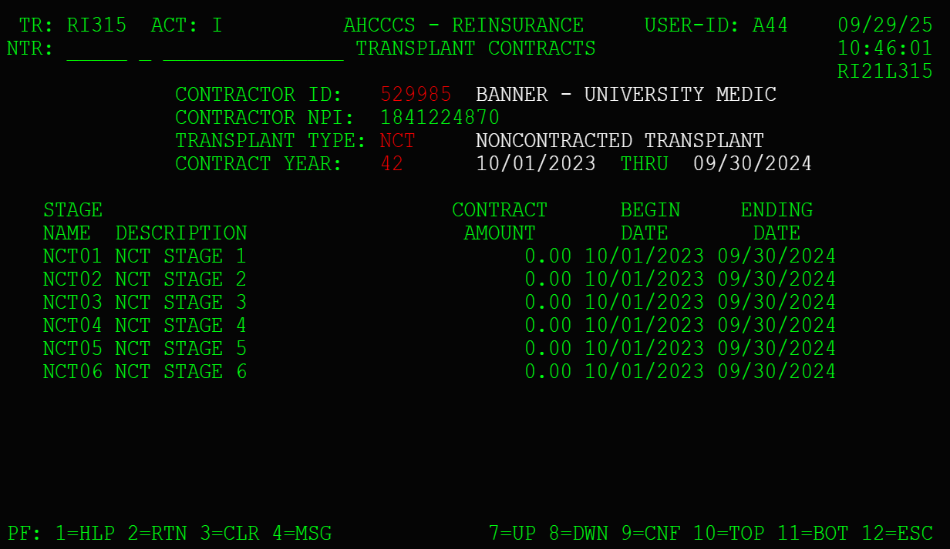
Reinsurance Discussion
NCT Contract Screen:

Slide 21
Reinsurance Recaps
61+ claims are captured on the 61+ Transplant stage.
61 + Claims are reinsured on RAC cases.
Member RAC deductible must be met for reinsurance of 61 + Claims.

Slide 22
Reinsurance Recaps
Interim inpatient stays where there has been a change of Managed Care Organization (MCO) during the stay can be reinsured if MCO has member on end date of service of stay. See AHCCCS APR-DRG Payment System Design Payment Policies - section 5.

Slide 23
Reinsurance Recaps
Transplant Outlier Stage submissions must include Transplant Stage Invoice Coversheets of all AHCCCS reimbursed stages that are part of the Outlier per RI Manual.

Slide 24
Reinsurance Recaps
Notify Reinsurance when you submit a transplant stage where the payment encounter has both the stage payment and an outlier payment.

Slide 25
Reinsurance Recaps
Mayo 61-100 Stages were developed for member continuity of care.
Mayo 61-100 Stages are for reinsurance of outpatient and HCFA's only.
Mayo 61-100 Stages are reimbursed at the AHCCCS Allowed.

Slide 26
Reinsurance Reminders
The billing for pre-transplant hospital stays follows section 31 in APR-DRG Payment System Design Payment Policies found on the AHCCCS Website.

Slide 27
Reinsurance Reminders
Total Body Irradiation is authorized by AHCCCS MM and billed as a separate TBI Case type.

Slide 28
Reminders
Shore up Transplant stage dates that extend into following contract year.
Delete stages that are not in the correct contract year of the case.
Delete inactive stages that are not needed or activate needed stages and shore up dates that extend into the following contract year.
Not doing these things can create a lot of work for you and AHCCCS Reinsurance since CRNs that are not part of a stage can associate in error. This can require Reinsurance Action Requests and CRN transfers to correct which are very time consuming.

Slide 29
More Reminders
A room and board rev code must be on the first line of UBs for them to be reinsured.
Please review your cases in PMMIS before submitting Reinsurance Action Requests and Transplant submissions.
Please use correct forms for submitting for reinsurance (e.g., Reinsurance Action Requests, Case Creation Form, Catastrophic or Transplant CRN Transfer Forms).
Complete forms completely.
Submit your SNF Grids ASAP if you haven't already.

Slide 30
More Reinsurance Reminders
SNF Rates should have the DAP included in rates.
Do not forget to monitor your cases over $1,000,000 so you can request to receive enhanced reinsurance.
Do not forget to request your catastrophic cases timely, (i.e., HEM, VON, GCC, BIO).
Do not forget to review your aged Transplant report AHCCCS Reinsurance provides monthly.

Slide 31
Last of the Reminders
There is no Transplant Reinsurance for Kidney Transplants as they are capitated.
All Transplant providers must be registered.
Notwithstanding the denial of reinsurance by AHCCCS, the Contractor is responsible for payment of claims for all services approved by the Contractor.

Slide 32
Reinsurance Announcement
Tracy will be retiring the end of this year.

Slide 33
AHCCCS
Health Plans
Providers

Slide 34
Questions?

